Slide 1
Chapter -5
One Dimensional Random Variable
Definitions of Random variable
A variable whose value is unknown or a function that assigns values to each of an experiment's outcomes.
Random variables are often designated by letters and can be classified as
discrete, which are variables that have specific values, or
continuous, which are variables that can have any values within a continuous range.

Slide 2
A probability distribution is a description of the chance a random variable has of taking on particular values. It is often displayed in a graph, table, or formula.
Random variable is a variable X whose value is determined by the outcomes of random experiment. It is classified as ;
Discrete random variable
Continuous random variable

Slide 3
Discrete random variable:
Possible values of isolated points along the number line. Random variables have their own sample space, or set of possible values. If this set is finite or countable, the random variable is said to be discrete.
If X is a discrete random variable taking a values X₁,X₂,….,Xn then P(x_{i})=P(X=x_{i}),where i=1,2,3,….,n is called probability mass function(pmf) of random variable X
The set of order pairs [x_{i} = P(x_{i})], i=1,2,3,….,n gives the probability distribution of random variable X

Slide 4
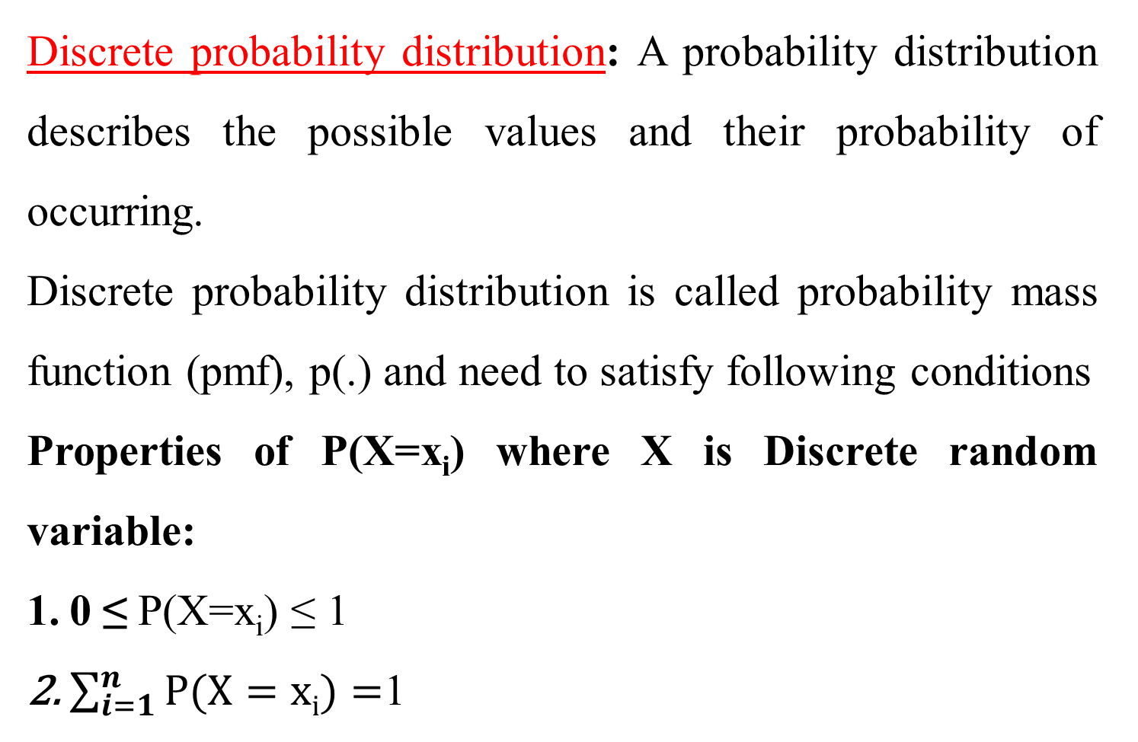
Discrete probability distribution: A probability distribution describes the possible values and their probability of occurring.
Discrete probability distribution is called probability mass function (pmf), p(.) and need to satisfy following conditions
Properties of P(X=x_{i}) where X is Discrete random variable:
0 ≤ P(X=x_{i}) ≤ 1
$\sum_{i=1}^{n}{P(X=xi)}=$1

Slide 5
Example: consider the experiment of tossing a coin three times let ‘x’ be the number of heads then write the probability distribution of the random variable x
Solution:
The variable ‘x’ takes the value 0,1,2,3 with probability distribution {HHH, HHT, HTH, TTH, THT, THH, HTT, TTT} then the probability distribution for ‘x’
X | 0 | 1 | 2 | 3
P(X) | 1/8 | 3/8 | 3/8 | 1/8

Slide 6
2. Continuous random variable:
A random variable X is said to be continuous if it can take all possible values (integral as well as fractional) between certain limits or intervals. Continuous random variables occur when we deal with quantities that are measured on a continuous scale.
For instance, the life length of an electric bulb, the speed of a car, weights, heights, and the like are continuous

Slide 7
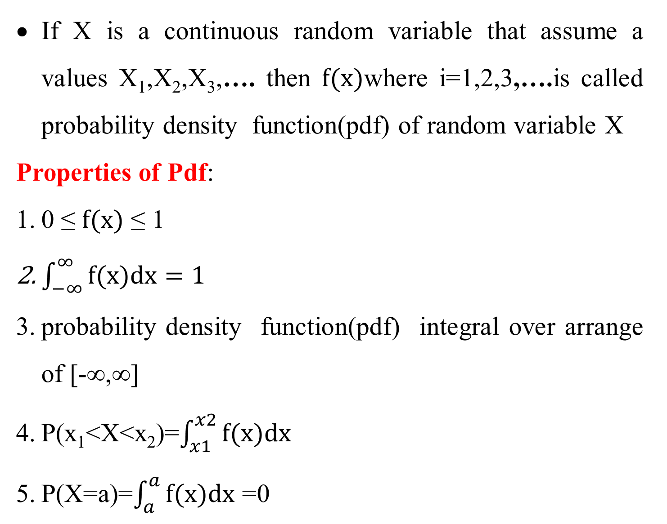
If X is a continuous random variable that assume a values X₁,X₂,X₃,…. then $f(x)$where i=1,2,3,….is called probability density function(pdf) of random variable X
Properties of Pdf:
0 ≤ $f(x)$ ≤ 1
$\int_{−∞}^{∞}{f(x)dx=1}$
probability density function(pdf) integral over arrange of [-∞,∞]
P(x₁<X<x₂)=$\int_{x1}^{x2}{f(x)dx}$
P(X=a)=$\int_{a}^{a}{f(x)dx}$ =0

Slide 8
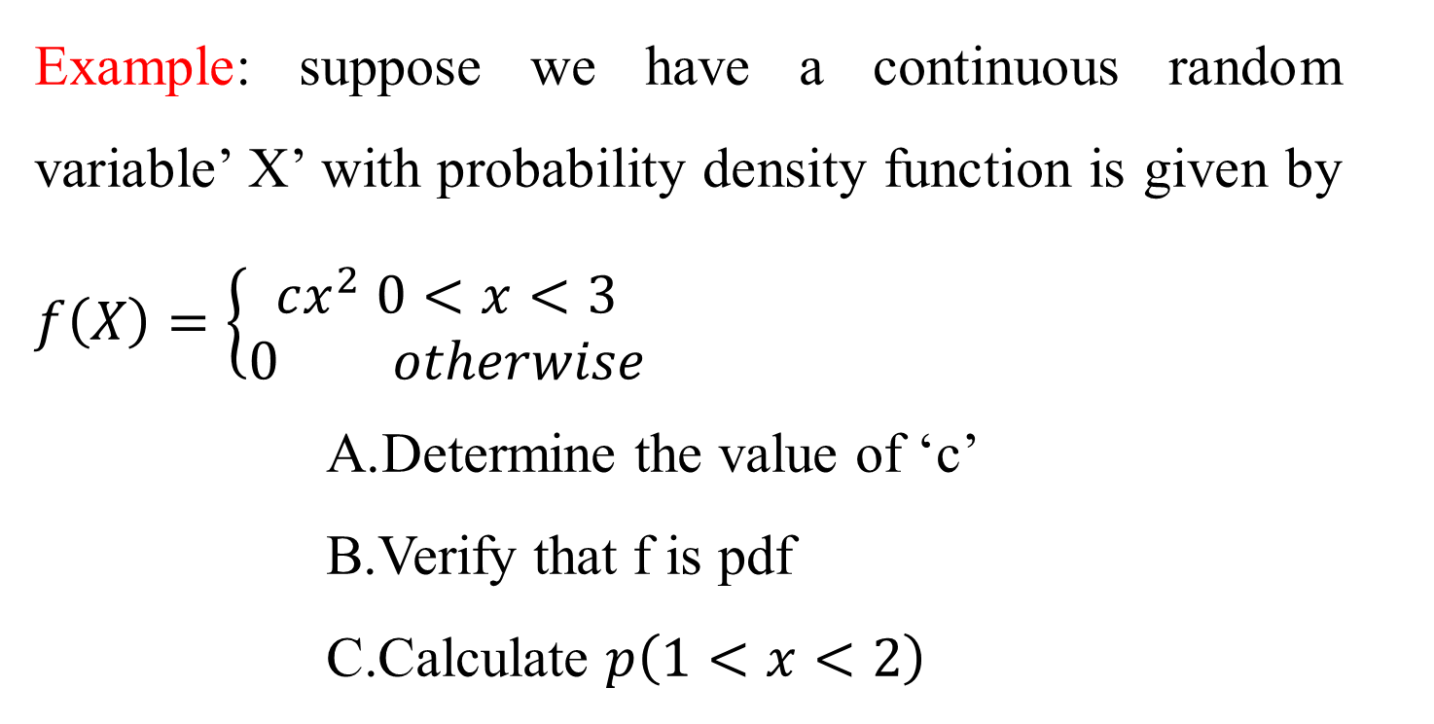
Example: suppose we have a continuous random variable’ X’ with probability density function is given by $f\left(X\right)=\left\{\begin{aligned}cx^{2} 0<x<3 \\ 0 otherwise\end{aligned}\right.$
Determine the value of ‘c’
Verify that f is pdf
Calculate $p\left(1<x<2\right)$

Slide 9
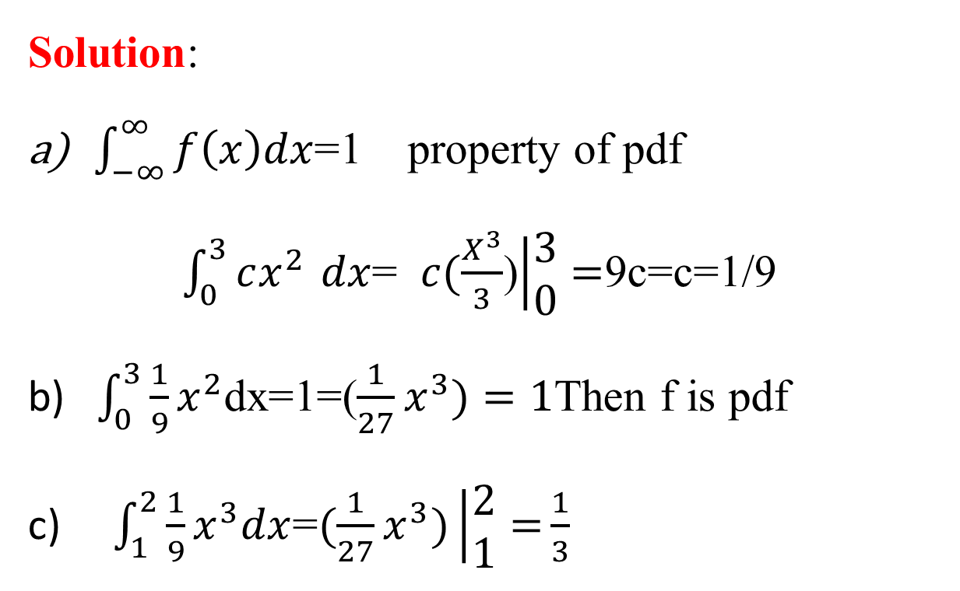
Solution:
$\int_{−∞}^{∞}{f\left(x\right)dx}$=1 property of pdf
$\int_{0}^{3}{cx^{2 }}dx$= $c(\frac{X^{3}}{3}$)$\left|\begin{aligned}3 \\ 0\end{aligned}\right.=$9c=c=1/9
b) $\int_{0}^{3}{\frac{1}{9}}x^{2}$dx=1=($\frac{1}{27}x^{3})=1$Then f is pdf
c) $\int_{1}^{2}{\frac{1}{9}}x^{3}dx$=$(\frac{1}{27}x^{3})\left|\begin{aligned}2 \\ 1\end{aligned}=\right.\frac{1}{3}$

Slide 10
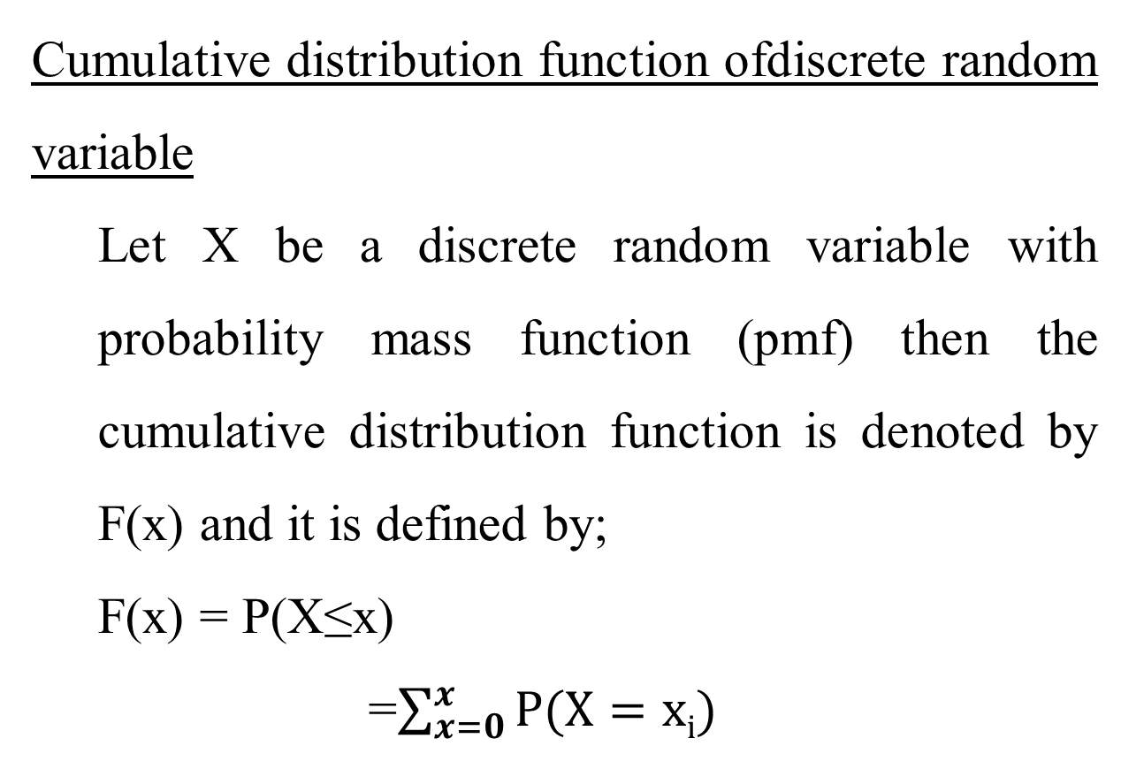
Cumulative distribution function ofdiscrete random variable
Let X be a discrete random variable with probability mass function (pmf) then the cumulative distribution function is denoted by F(x) and it is defined by;
F(x) = P(X≤x)
=$\sum_{x=0}^{x}{P(X=xi)}$

Slide 11
Example: Tossing a coin three time, let X be getting the numbers of head, then find the CDF of x
Solution: The variable ‘x’ takes the value 0,1,2,3 with probability distribution
(HHH, HHT, HTH, TTH, THT, THH, HTT, TTT)
x | P(x) | F(X)
0 | 1/8 | 1/8
1 | 3/8 | 4/8
2 | 3/8 | 7/8
3 | 1/8 | 1

Slide 12
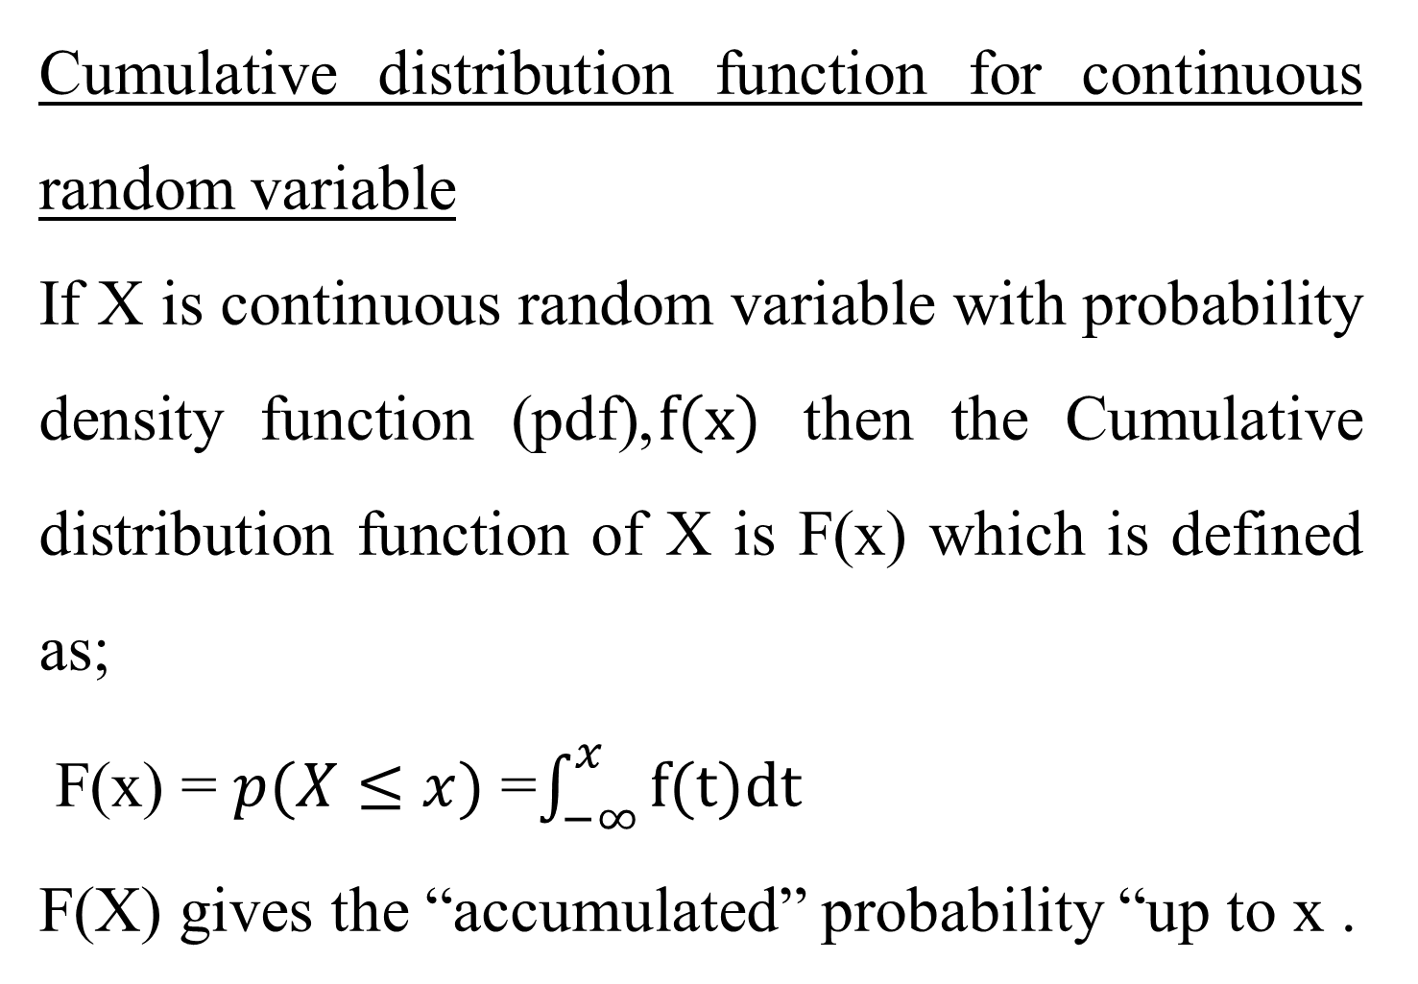
Cumulative distribution function for continuous random variable
If X is continuous random variable with probability density function (pdf),$f(x)$ then the Cumulative distribution function of X is F(x) which is defined as;
F(x) = $p(X≤x)$ =$\int_{−∞}^{x}{f(t)dt}$
F(X) gives the “accumulated” probability “up to x .

Slide 13
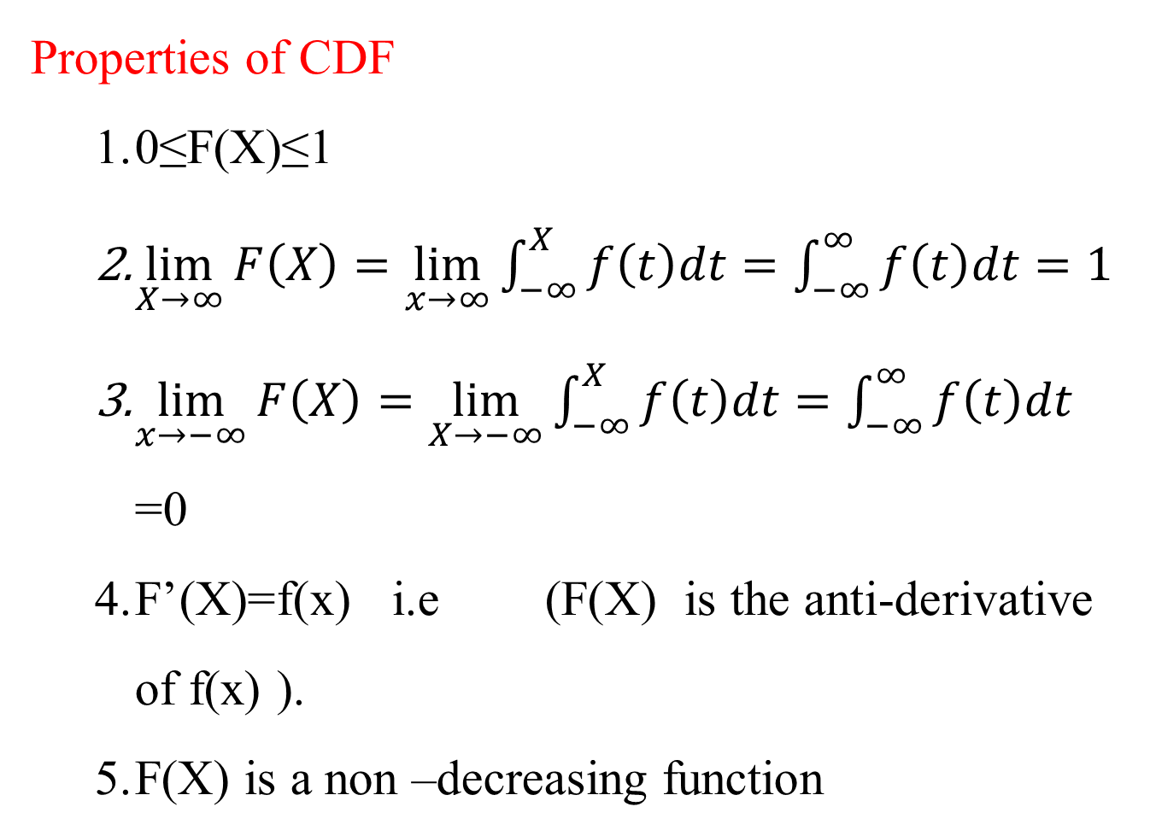
Properties of CDF
0≤F(X)≤1
$\lim_{X→∞}{F\left(X\right)=\lim_{x→∞}{\int_{−∞}^{X}{f\left(t\right)dt}}=\int_{−∞}^{∞}{f\left(t\right)dt=1}}$
$\lim_{x→−∞}{F\left(X\right)=\lim_{X→−∞}{\int_{−∞}^{X}{f\left(t\right)dt=\int_{−∞}^{∞}{f\left(t\right)dt}}}}$=0
F’(X)=f(x) i.e (F(X) is the anti-derivative of f(x) ).
F(X) is a non –decreasing function

Slide 14
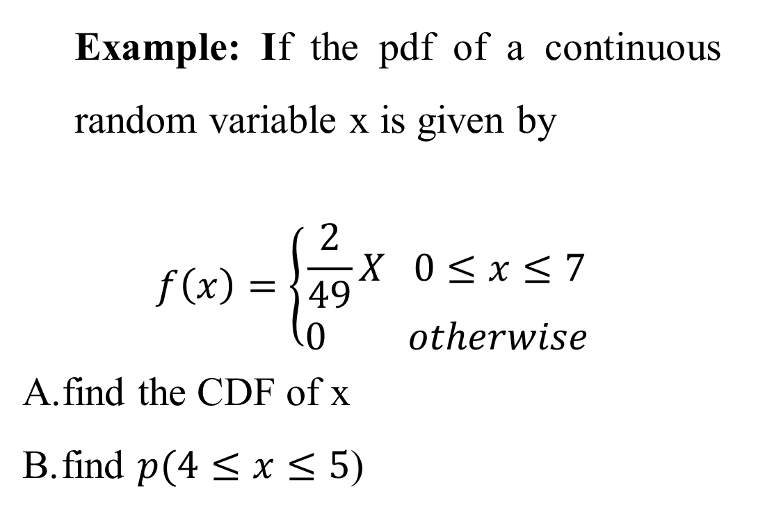
Example: If the pdf of a continuous random variable x is given by
$$f\left(x\right)=\left\{\begin{aligned}\frac{2}{49}X 0≤x≤7 \\ 0 otherwise\end{aligned}\right.$$
find the CDF of x
find $p(4≤x≤5$)

Slide 15
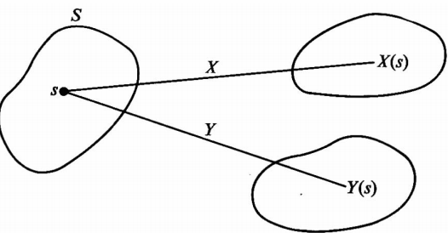
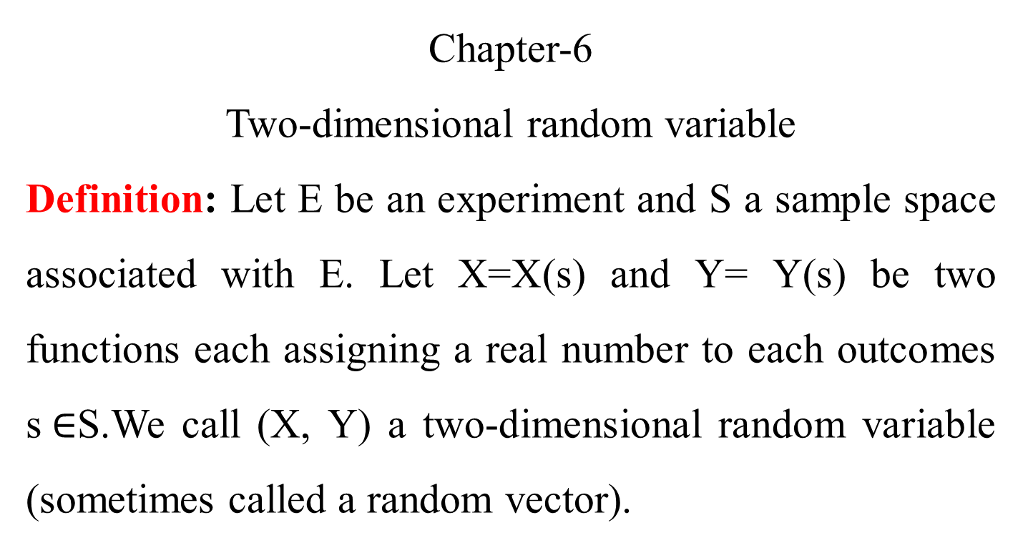
Chapter-6
Two-dimensional random variable
Definition: Let E be an experiment and S a sample space associated with E. Let X=X(s) and Y= Y(s) be two functions each assigning a real number to each outcomes s$∈$S.We call (X, Y) a two-dimensional random variable (sometimes called a random vector).

Slide 16
Example:
recording the amount of precipitate (p) and volume of gas (q) for a given locality, (p,q)
Observing the rainfall (R) and temperature (T) of certain town (R, T)
Note: If the possible values (x, y) are finite countable infinite, then (x, y) is called two-dimensional discrete random variable.
If (x, y) assumes all values in a specified region R in the xy-plane then (x,y) is called two-dimensional continuous random variable.

Slide 17
Joint probability distribution
If X and Y are two random variable the probability distribution for their simultaneous occurrences can be represented by a function f(x,y),for any pair values (X,Y) within the range of the random variable X and Y. This function is known as joint probability distribution (X, Y).

Slide 18
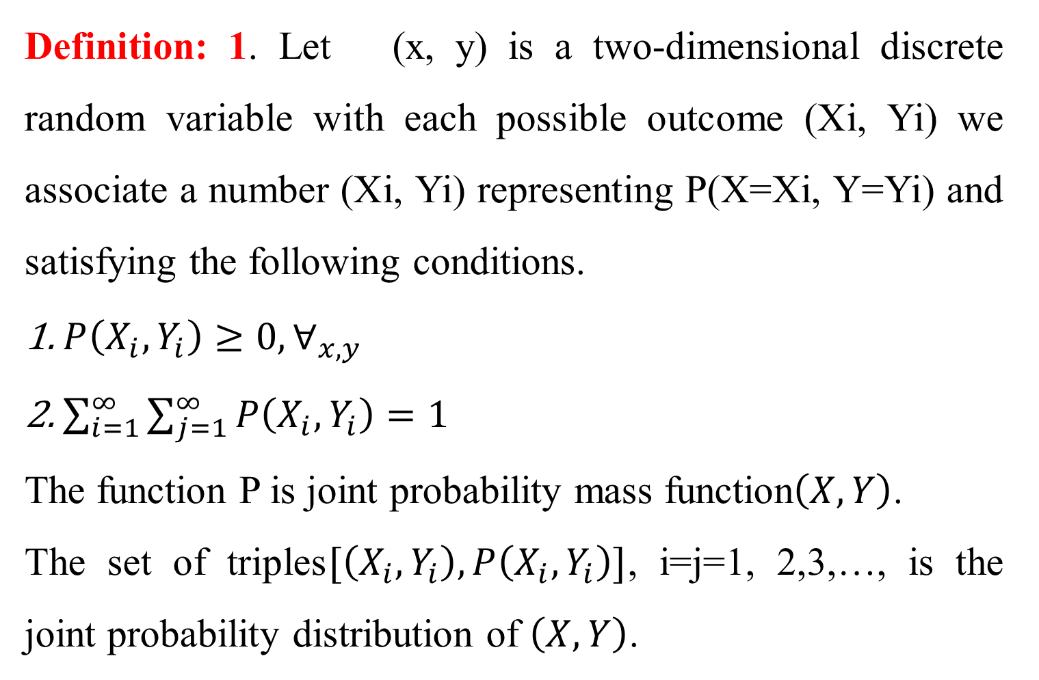
Definition: 1. Let (x, y) is a two-dimensional discrete random variable with each possible outcome (Xi, Yi) we associate a number (Xi, Yi) representing P(X=Xi, Y=Yi) and satisfying the following conditions.
$P\left(X_{i}, Y_{i}\right)≥0,∀_{x,y}$
$\sum_{i=1}^{∞}{\sum_{j=1}^{∞}{P\left(X_{i}, Y_{i}\right)=1}}$
The function P is joint probability mass function$\left(X, Y\right)$.
The set of triples$[\left(X_{i}, Y_{i}\right), P\left(X_{i}, Y_{i}\right)]$, i=j=1, 2,3,…, is the joint probability distribution of $\left(X, Y\right)$.

Slide 19
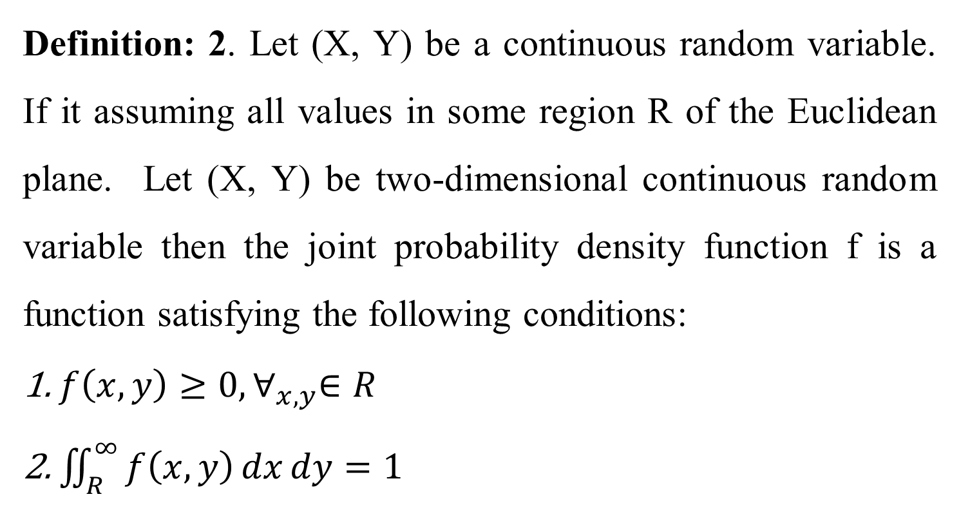
Definition: 2. Let (X, Y) be a continuous random variable. If it assuming all values in some region R of the Euclidean plane. Let (X, Y) be two-dimensional continuous random variable then the joint probability density function f is a function satisfying the following conditions:
$f\left(x, y\right)≥0,∀_{x,y}∈R$
$\iint_{R}^{∞}{f\left(x, y\right)dxdy}=1$

Slide 20
Example:
Two production lines 1 and 2 have a capacity of producing 5 and 3 items per day respectively, assume the numbers of items produced by each line is a random variable. Let x, y be a two-dimensional random variable yielding the number of items produced by line 1 and line 2 respectively.
Y|X | 0 | 1 | 2 | 3 | 4 | 5
0 | 0 | 0.01 | 0.03 | 0.05 | 0.07 | 0.09
1 | 0.01 | 0.02 | 0.04 | 0.05 | 0.06 | 0.08
2 | 0.01 | 0.03 | 0.05 | 0.05 | 0.05 | 0.06
3 | 0.01 | 0.02 | 0.04 | 0.06 | 0.06 | 0.05

Slide 21
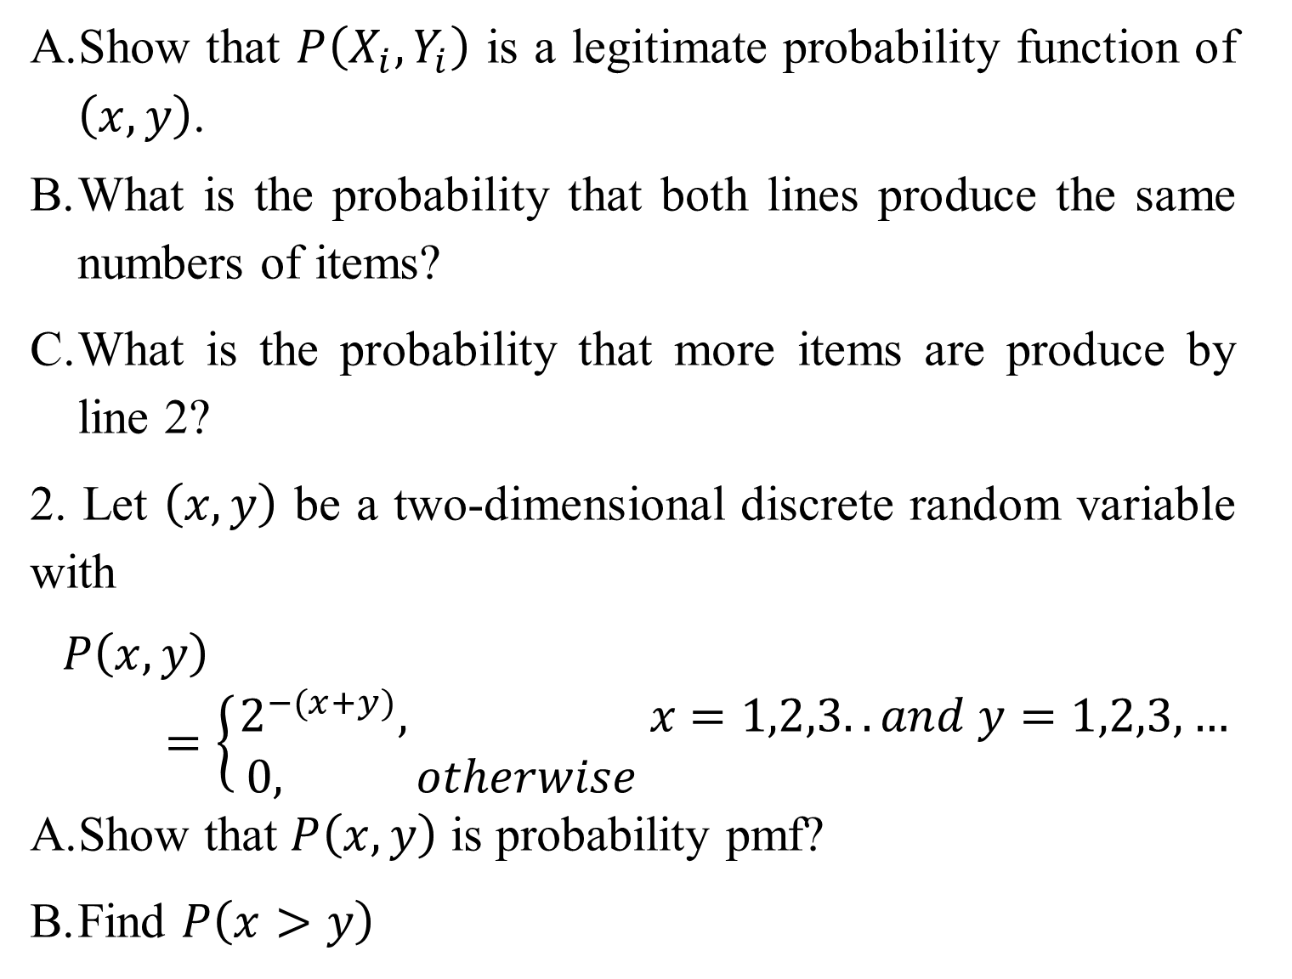
Show that $P\left(X_{i}, Y_{i}\right)$ is a legitimate probability function of $\left(x, y\right)$.
What is the probability that both lines produce the same numbers of items?
What is the probability that more items are produce by line 2?
2. Let $\left(x, y\right)$ be a two-dimensional discrete random variable with
$$P\left(x, y\right)=\left\{\begin{aligned}2^{−(x+y)}, &x=1,2,3.. and y=1,2,3,… \\ 0, otherwise &\end{aligned}\right.$$
Show that $P\left(x, y\right)$ is probability pmf?
Find $P\left(x>y\right)$

Slide 22
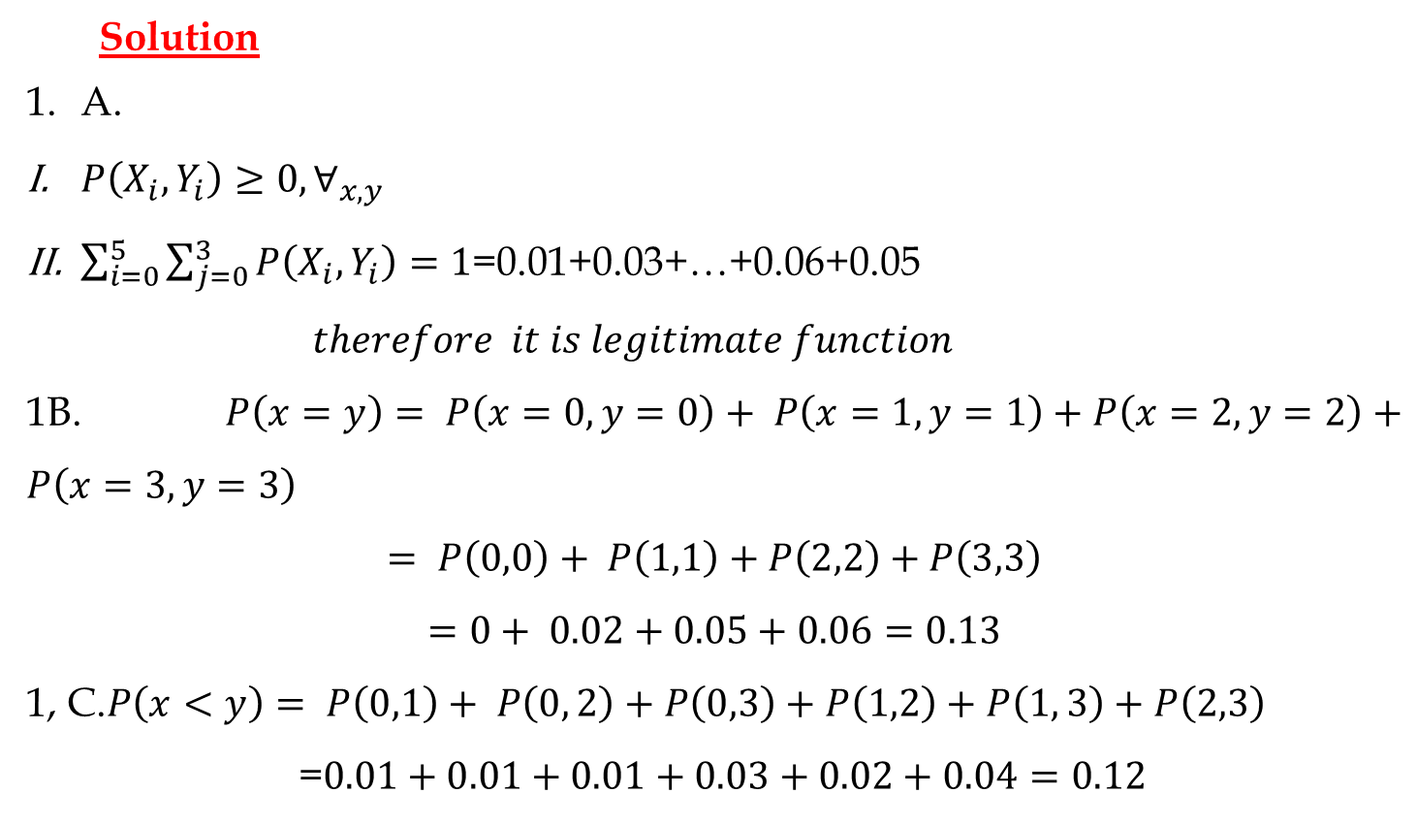
Solution
A.
$P\left(X_{i}, Y_{i}\right)≥0,∀_{x,y}$
$\sum_{i=0}^{5}{\sum_{j=0}^{3}{P\left(X_{i}, Y_{i}\right)=1}}$=0.01+0.03+…+0.06+0.05
$$therefore it is legitimate function$$
1B. $P\left(x=y\right)= P\left(x=0,y=0\right)+ P\left(x=1,y=1\right)+P\left(x=2,y=2\right)+P\left(x=3,y=3\right)$
$$= P\left(0,0\right)+ P\left(1,1\right)+P\left(2,2\right)+P\left(3,3\right)$$
$$=0+ 0.02+0.05+0.06=0.13$$
1, C.$P\left(x<y\right)= P\left(0,1\right)+ P\left(0, 2\right)+P\left(0,3\right)+P\left(1,2\right)+P\left(1, 3\right)+P\left(2,3\right)$
=$0.01+0.01+0.01+0.03+0.02+0.04=0.12$

Slide 23
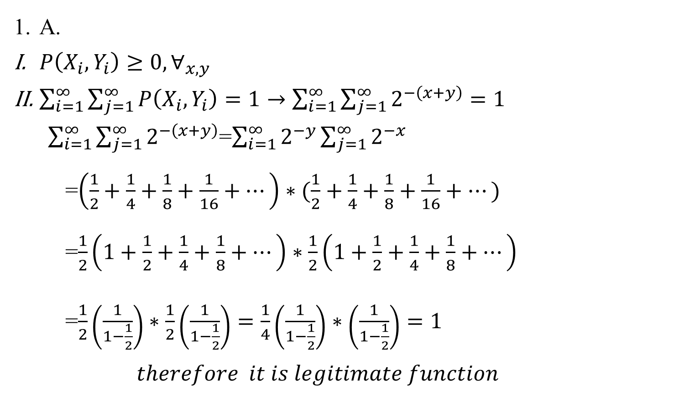
A.
$P\left(X_{i}, Y_{i}\right)≥0,∀_{x,y}$
$\sum_{i=1}^{∞}{\sum_{j=1}^{∞}{P\left(X_{i}, Y_{i}\right)=1}}→\sum_{i=1}^{∞}{\sum_{j=1}^{∞}{2^{−\left(x+y\right)}=1}}$
$\sum_{i=1}^{∞}{\sum_{j=1}^{∞}{2^{−\left(x+y\right)}}}$=$\sum_{i=1}^{∞}{2^{−y}\sum_{j=1}^{∞}{2^{−x}}}$
=$\left(\frac{1}{2}+\frac{1}{4}+\frac{1}{8}+\frac{1}{16}+…\right)∗(\frac{1}{2}+\frac{1}{4}+\frac{1}{8}+\frac{1}{16}+…)$
=$\frac{1}{2}\left(1+\frac{1}{2}+\frac{1}{4}+\frac{1}{8}+…\right)∗\frac{1}{2}\left(1+\frac{1}{2}+\frac{1}{4}+\frac{1}{8}+…\right)$
=$\frac{1}{2}\left(\frac{1}{1−\frac{1}{2}}\right)∗\frac{1}{2}\left(\frac{1}{1−\frac{1}{2}}\right)=\frac{1}{4}\left(\frac{1}{1−\frac{1}{2}}\right)∗\left(\frac{1}{1−\frac{1}{2}}\right)=1$
$$therefore it is legitimate function$$

Slide 24
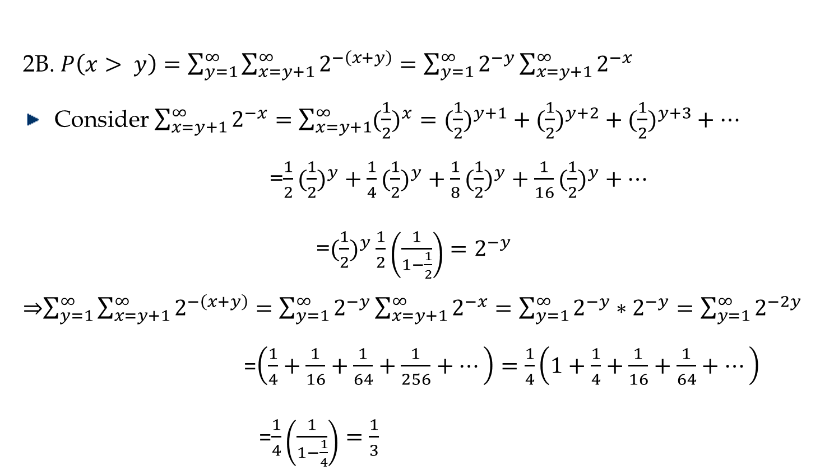
2B. $P\left(x> y\right)=\sum_{y=1}^{∞}{\sum_{x=y+1}^{∞}{2^{−\left(x+y\right)}}}=\sum_{y=1}^{∞}{2^{−y}\sum_{x=y+1}^{∞}{2^{−x}}}$
Consider $\sum_{x=y+1}^{∞}{2^{−x}}=\sum_{x=y+1}^{∞}{({\frac{1}{2})}^{x}=({\frac{1}{2})}^{y+1}+({\frac{1}{2})}^{y+2}+({\frac{1}{2})}^{y+3}+…}$
=$\frac{1}{2}({\frac{1}{2})}^{y}+\frac{1}{4}({\frac{1}{2})}^{y}+\frac{1}{8}({\frac{1}{2})}^{y}+\frac{1}{16}({\frac{1}{2})}^{y}+…$
=$({\frac{1}{2})}^{y}\frac{1}{2}\left(\frac{1}{1−\frac{1}{2}}\right)=2^{−y}$
⇒$\sum_{y=1}^{∞}{\sum_{x=y+1}^{∞}{2^{−\left(x+y\right)}}}=\sum_{y=1}^{∞}{2^{−y}\sum_{x=y+1}^{∞}{2^{−x}}}=\sum_{y=1}^{∞}{2^{−y}∗2^{−y}}=\sum_{y=1}^{∞}{2^{−2y}}$
=$\left(\frac{1}{4}+\frac{1}{16}+\frac{1}{64}+\frac{1}{256}+…\right)=\frac{1}{4}\left(1+\frac{1}{4}+\frac{1}{16}+\frac{1}{64}+…\right)$
=$\frac{1}{4}\left(\frac{1}{1−\frac{1}{4}}\right)=\frac{1}{3}$

Slide 25
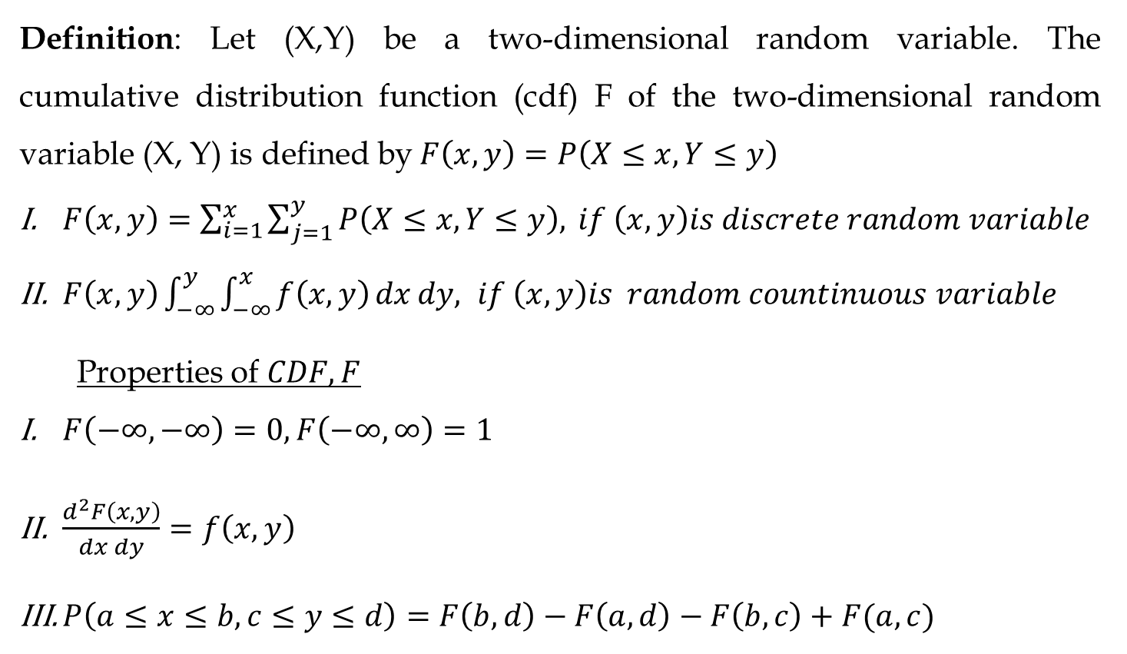
Definition: Let (X,Y) be a two-dimensional random variable. The cumulative distribution function (cdf) F of the two-dimensional random variable (X, Y) is defined by$F\left(x, y\right)=P\left(X≤x, Y≤y\right)$
$F\left(x, y\right)=\sum_{i=1}^{x}{\sum_{j=1}^{y}{P\left(X≤x, Y≤y\right),}} if \left(x,y\right)is discrete random variable$
$F\left(x, y\right)\int_{−∞}^{y}{\int_{−∞}^{x}{f\left(x, y\right)}}dxdy, if \left(x,y\right)is random countinuous variable$
Properties of $CDF,F$
$F\left(−∞, −∞\right)=0,F\left(−∞, ∞\right)=1$
$\frac{d^{2}F\left(x, y\right)}{dxdy}=f\left(x, y\right)$
$P\left(a≤x≤b, c≤y≤d\right)=F\left(b,d\right)−F\left(a,d\right)−F\left(b,c\right)+F(a,c)$

Slide 26
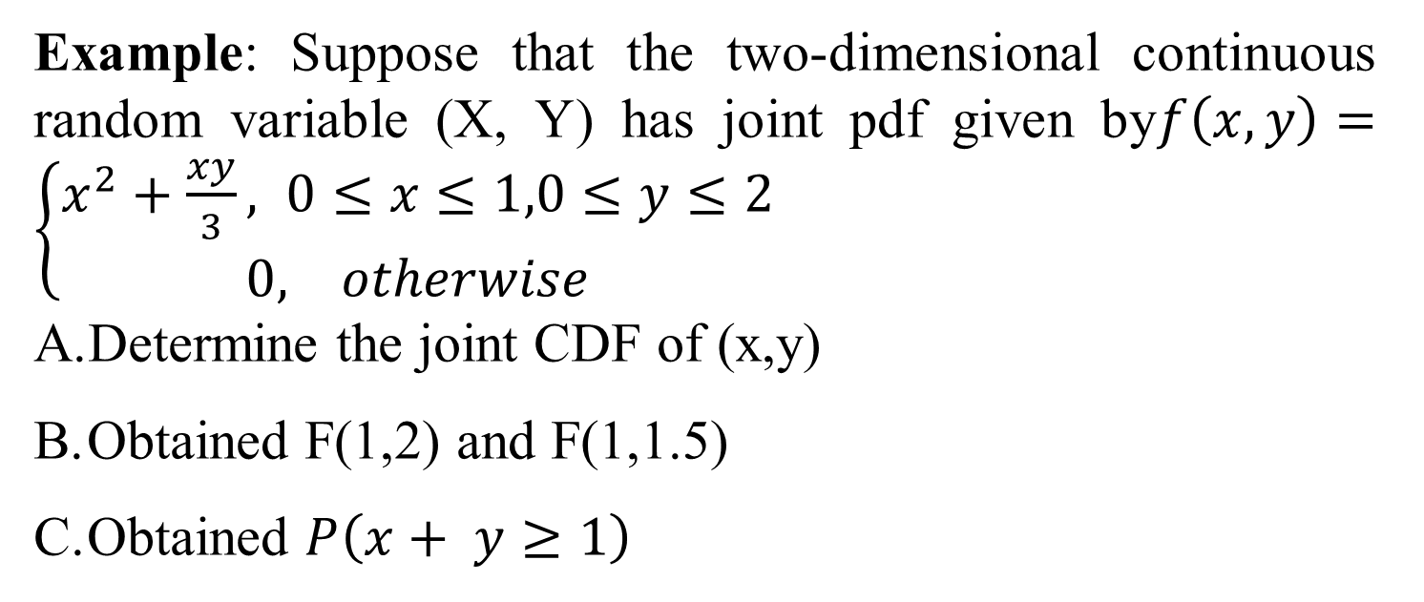
Example: Suppose that the two-dimensional continuous random variable (X, Y) has joint pdf given by$f\left(x, y\right)=\left\{\begin{aligned}x^{2}+\frac{xy}{3}, 0≤&x≤1,0≤y≤2 \\ 0, otherwise\end{aligned}\right.$
Determine the joint CDF of (x,y)
Obtained F(1,2) and F(1,1.5)
Obtained $P\left(x+ y≥1\right)$

Slide 27
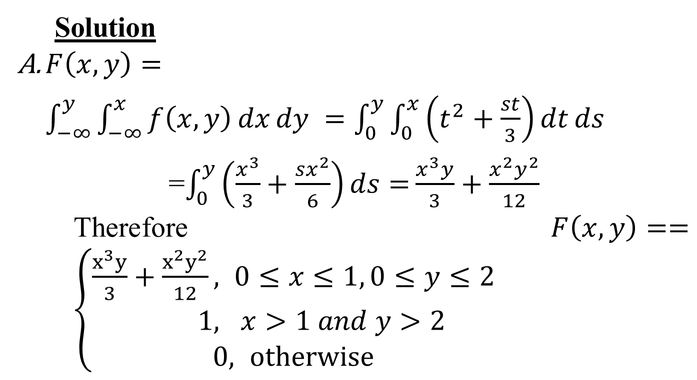
Solution
$F\left(x, y\right)=\int_{−∞}^{y}{\int_{−∞}^{x}{f\left(x, y\right)}}dxdy =\int_{0}^{y}{\int_{0}^{x}{\left(t^{2}+\frac{st}{3}\right)}}dtds$
=$\int_{0}^{y}{\left(\frac{x^{3}}{3}+\frac{sx^{2}}{6}\right)ds=}\frac{x^{3}y}{3}+\frac{x^{2}y^{2}}{12}$
Therefore$F\left(x, y\right)==\left\{\begin{aligned}\frac{x^{3}y}{3}+\frac{x^{2}y^{2}}{12}, &0≤x≤1, 0≤y≤2 \\ 1, & x>1 and y>2 \\ 0, otherwise\end{aligned}\right.$

Slide 28
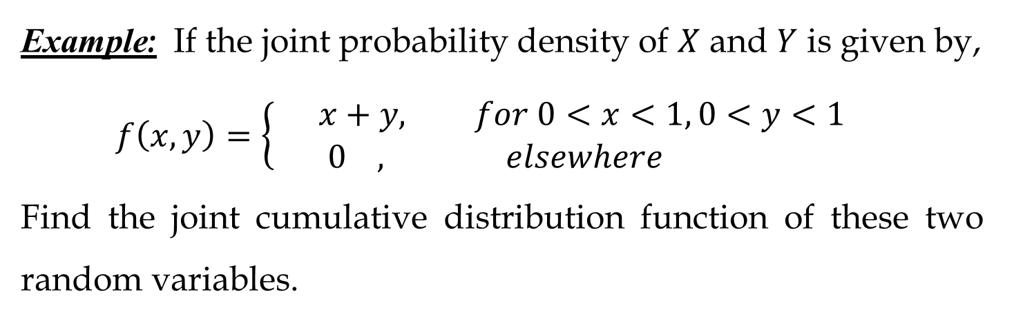
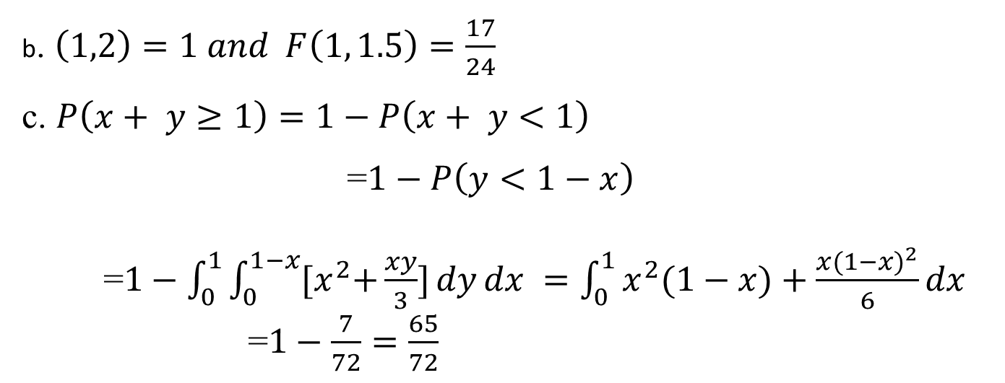
b. $\left(1,2\right)=1 and F\left(1, 1.5\right)=\frac{17}{24}$
c. $P\left(x+ y≥1\right)=1−P\left(x+ y<1\right)$
=$1−P\left(y<1−x\right)$
=$1−\int_{0}^{1}{\int_{0}^{1−x}{{[x}^{2}+\frac{xy}{3}]}}dydx =\int_{0}^{1}{x^{2}(1−x)+\frac{{x(1−x)}^{2}}{6}}dx$
=$1−\frac{7}{72}=\frac{65}{72}$
Example: If the joint probability density of $X$ and $Y$ is given by,
$$f\left(x,y\right)=\left\{\begin{aligned}x+y, for 0<x<1, 0<y<1 \\ 0 , elsewhere \end{aligned}\right.$$
Find the joint cumulative distribution function of these two random variables.

Slide 29
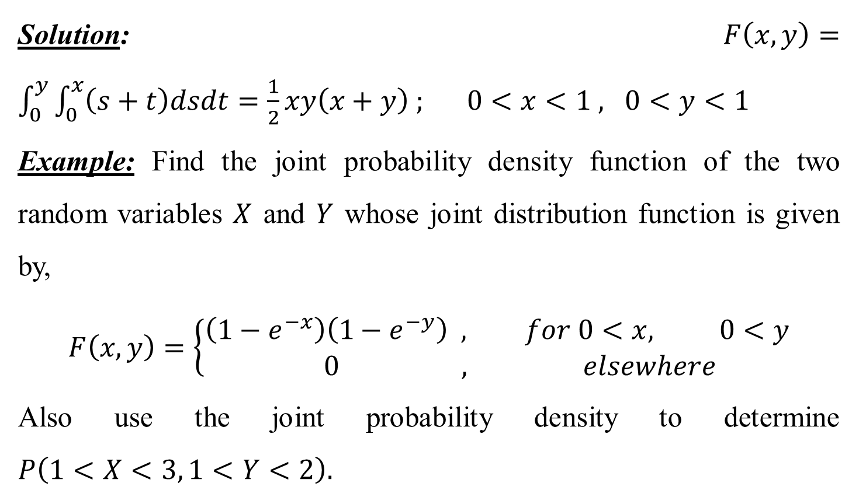
Solution:$F\left(x,y\right)=\int_{0}^{y}{\int_{0}^{x}{\left(s+t\right)dsdt=\frac{1}{2}xy\left(x+y\right) ; 0<x<1 , 0<y<1}}$
Example: Find the joint probability density function of the two random variables $X$ and $Y$ whose joint distribution function is given by,
$$F\left(x,y\right)=\left\{\begin{aligned}\left(1−e^{−x}\right)\left(1−e^{−y}\right) , for 0<x, 0<y \\ 0 , elsewhere \end{aligned}\right.$$
Also use the joint probability density to determine $P\left(1<X<3, 1<Y<2\right).$

Slide 30
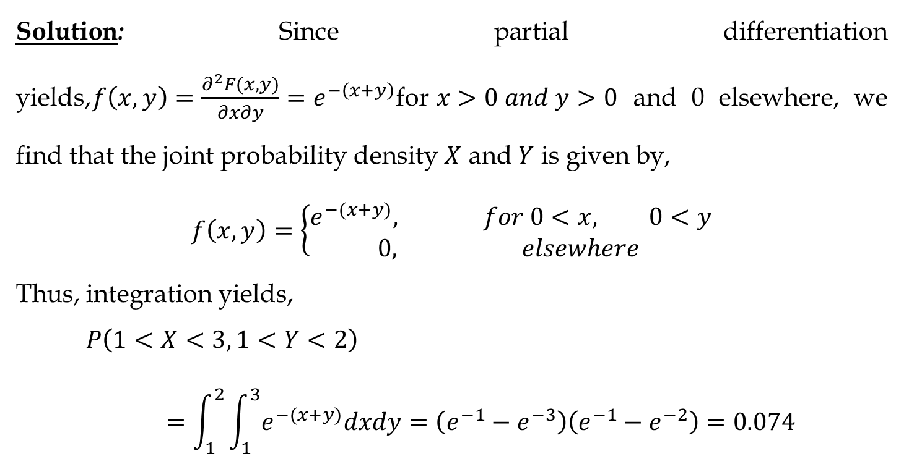
Solution: Since partial differentiation yields,$f\left(x,y\right)=\frac{∂^{2}F(x,y)}{∂x∂y}=e^{−\left(x+y\right)}$for$x>0 and y>0$ and 0 elsewhere, we find that the joint probability density $X$ and $Y$ is given by,
$$f\left(x,y\right)=\left\{\begin{aligned}e^{−(x+y)}, for 0<x, 0<y \\ 0, elsewhere \end{aligned}\right.$$
Thus, integration yields,
$$P\left(1<X<3, 1<Y<2\right)=\int_{1}^{2}{\int_{1}^{3}{e^{−(x+y)}dxdy=\left(e^{−1}−e^{−3}\right)\left(e^{−1}−e^{−2}\right)=0.074 }}$$

Slide 31
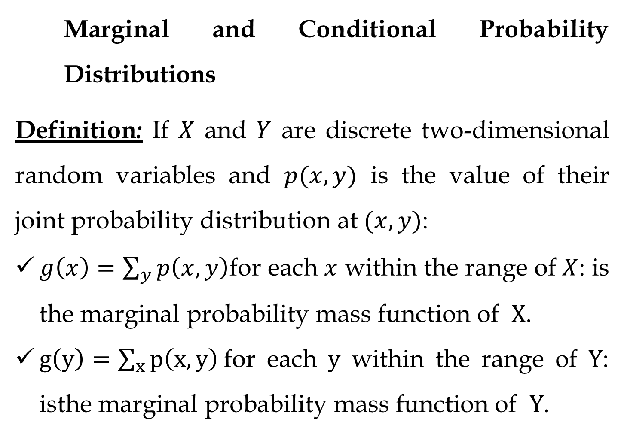
Marginal and Conditional Probability Distributions
Definition: If $X$ and $Y$ are discrete two-dimensional random variables and $p(x,y)$ is the value of their joint probability distribution at$(x,y)$:
$g\left(x\right)=\sum_{y}{p\left(x,y\right)}$for each $x$ within the range of $X$: is the marginal probability mass function of $X$.
$g\left(y\right)=\sum_{x}{p\left(x,y\right)}$for each $y$ within the range of $Y$: isthe marginal probability mass function of $Y$.

Slide 32
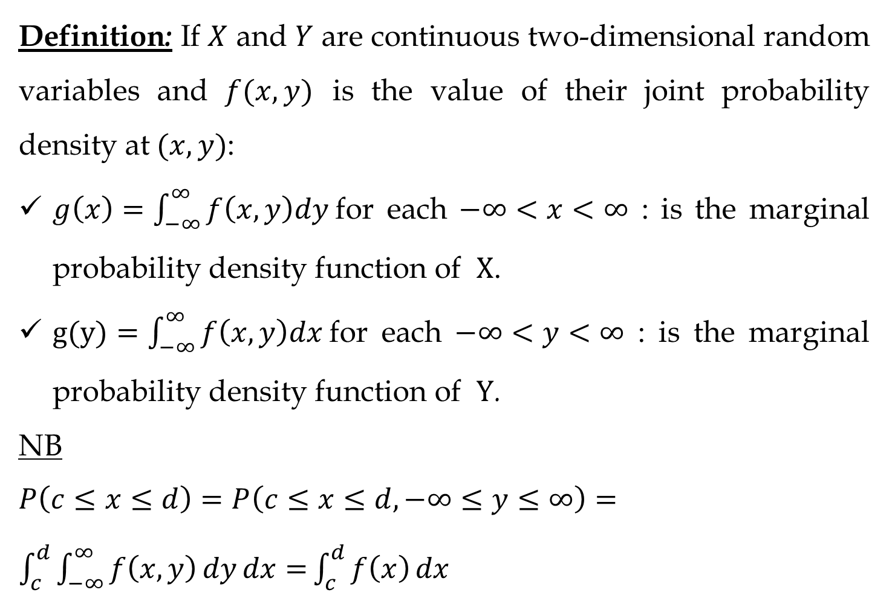
Definition: If $X$ and $Y$ are continuous two-dimensional random variables and $f(x,y)$ is the value of their joint probability density at$(x,y)$:
$g\left(x\right)=\int_{−∞}^{∞}{f\left(x,y\right)dy }$for each $−∞<x<∞$ : is the marginal probability density function of $X$.
$g(y)=\int_{−∞}^{∞}{f\left(x,y\right)dx }$for each $−∞<y<∞$ : is the marginal probability density function of $Y$.
NB $P\left(c≤x≤d\right)=P\left(c≤x≤d, −∞≤y≤∞\right)=\int_{c}^{d}{\int_{−∞}^{∞}{f\left(x, y\right)dydx=}}\int_{c}^{d}{f\left(x\right)}dx$

Slide 33
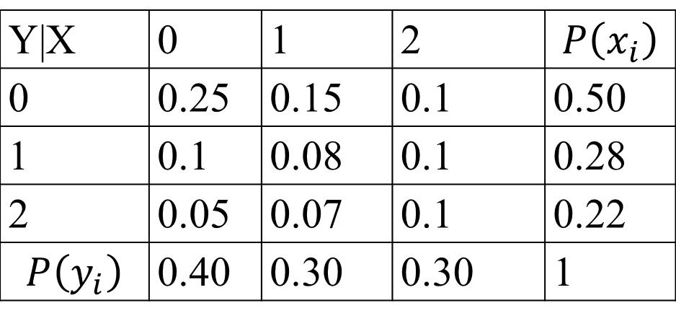
Example:
let (x,y) be the joint probability function given by:
Y|X | 0 | 1 | 2 | $$P\left(x_{i}\right)$$
0 | 0.25 | 0.15 | 0.1 | 0.50
1 | 0.1 | 0.08 | 0.1 | 0.28
2 | 0.05 | 0.07 | 0.1 | 0.22
$$P\left(y_{i}\right)$$ | 0.40 | 0.30 | 0.30 | 1
Find the marginal distribution function of X and Y
Solution:
The marginal distribution function of X is

Slide 34
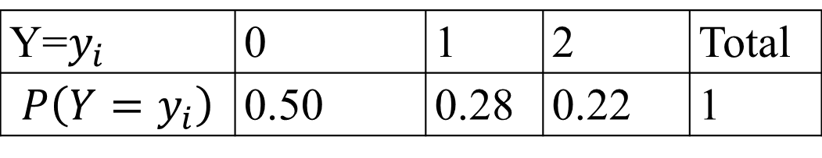
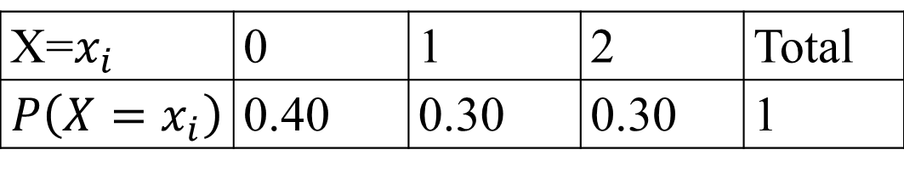
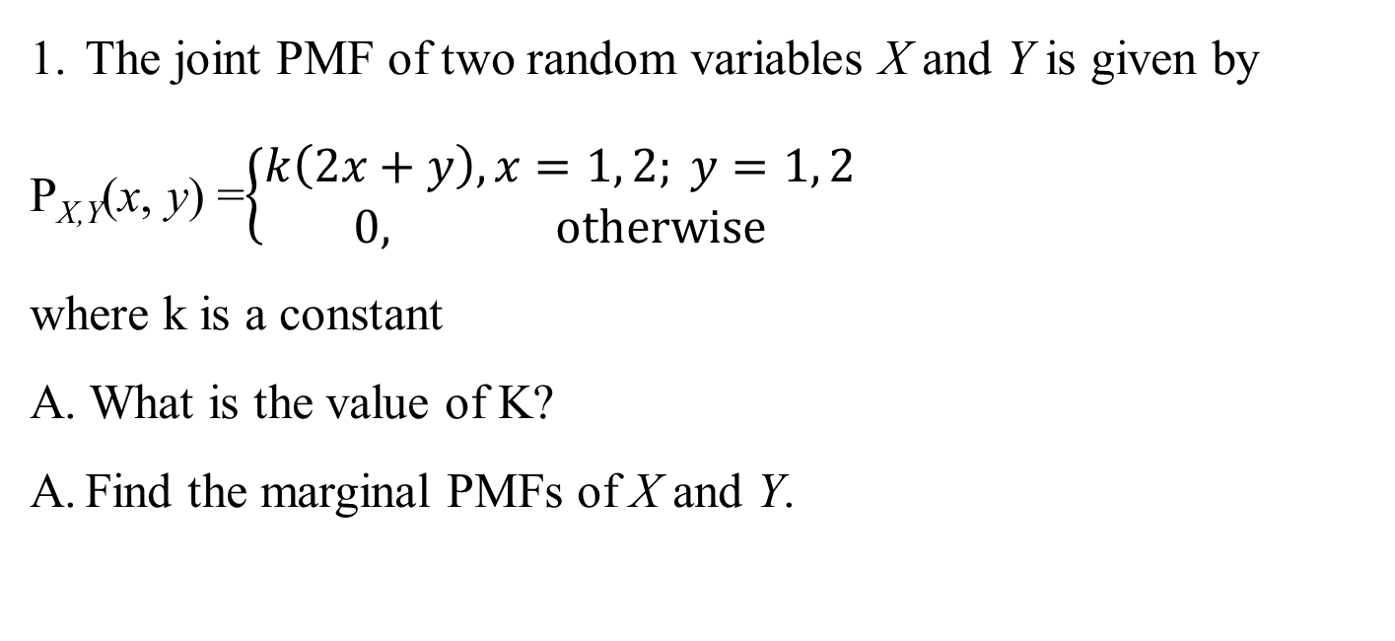
X=$x_{i}$ | 0 | 1 | 2 | Total
$$P\left(X=x_{i}\right)$$ | 0.40 | 0.30 | 0.30 | 1
ii. The marginal distribution function of Y are:
Y=$y_{i}$ | 0 | 1 | 2 | Total
$$P\left(Y=y_{i}\right)$$ | 0.50 | 0.28 | 0.22 | 1
The joint PMF of two random variables X and Y is given by
P_{X,Y}(x, y) =$\left\{\begin{aligned}k\left(2x+y\right), x=1, 2; y=1, 2 \\ 0, otherwise\end{aligned}\right.$
where k is a constant
A. What is the value of K?
Find the marginal PMFs of X and Y.

Slide 35
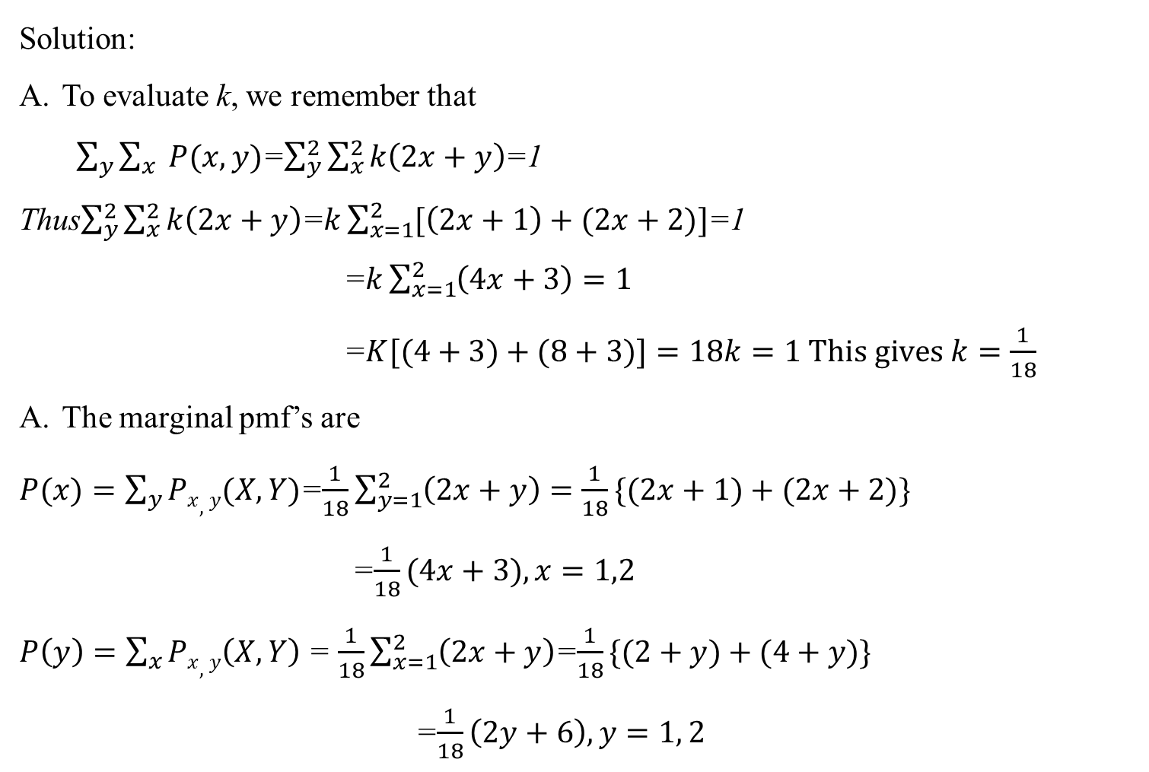
Solution:
To evaluate k, we remember that
$\sum_{y}{\sum_{x}{ P(x, y)}}$=$\sum_{y}^{2}{\sum_{x}^{2}{k\left(2x+y\right)}}$=1
Thus$\sum_{y}^{2}{\sum_{x}^{2}{k\left(2x+y\right)}}$=$k\sum_{x=1}^{2}{[\left(2x+1\right)+(2x+2)}]$=1
=$k\sum_{x=1}^{2}{\left(4x+3\right)}=1$
=$K[(4+3)+(8+3)]=18k=1 This gives k=\frac{1}{18}$
The marginal pmf’s are
$P(x)=\sum_{y}{Px,y(X, Y)}$=$\frac{1}{18}\sum_{y=1}^{2}{\left(2x+y\right)=\frac{1}{18}\{(2x+1)+(2x+2)\}}$
=$\frac{1}{18}(4x+3),x=1,2$
$P\left(y\right)=\sum_{x}{Px,y\left(X, Y\right)}$ = $\frac{1}{18}\sum_{x=1}^{2}{\left(2x+y\right)}$=$\frac{1}{18}\{(2+y)+(4+y)\}$
=$\frac{1}{18}\left(2y+6\right), y=1, 2$

Slide 36
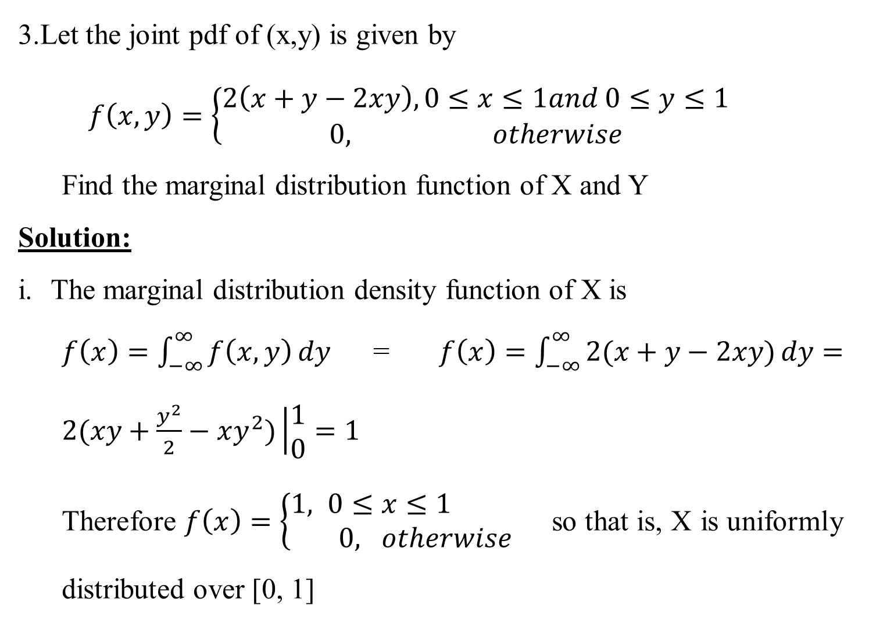
3.Let the joint pdf of (x,y) is given by
$$f\left(x, y\right)=\left\{\begin{aligned}2\left(x+y−2xy\right), 0≤x≤1and 0≤y≤1 \\ 0, otherwise\end{aligned}\right.$$
Find the marginal distribution function of X and Y
Solution:
The marginal distribution density function of X is
$f\left(x\right)=\int_{−∞}^{∞}{f\left(x, y\right)dy}$=$f\left(x\right)=\int_{−∞}^{∞}{2(x+y−2xy)dy}=2(xy+\frac{y^{2}}{2}−xy^{2})\left|\begin{aligned}1 \\ 0\end{aligned}=1\right.$
Therefore $f\left(x\right)=\left\{\begin{aligned}1, 0≤&x≤1 \\ 0, &otherwise\end{aligned}\right.$ so that is, X is uniformly distributed over [0, 1]

Slide 37
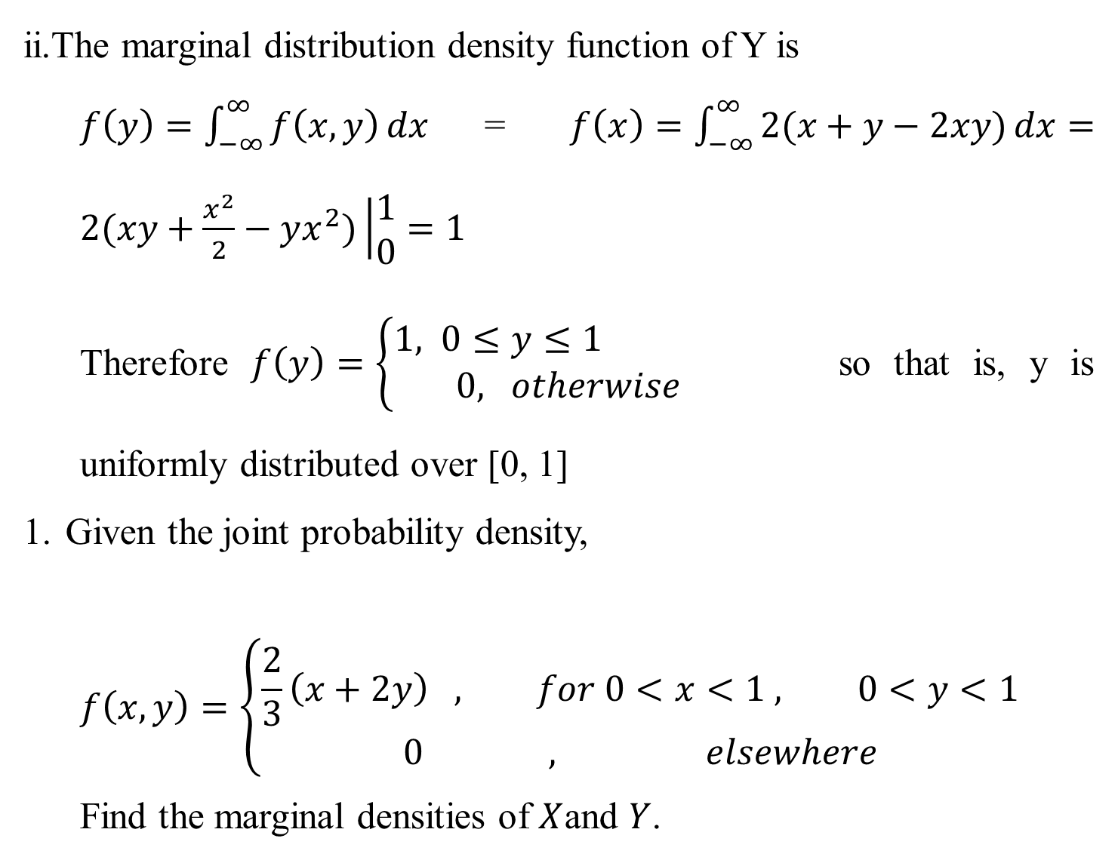
ii.The marginal distribution density function of Y is
$f\left(y\right)=\int_{−∞}^{∞}{f\left(x, y\right)dx}$=$f\left(x\right)=\int_{−∞}^{∞}{2(x+y−2xy)dx}=2(xy+\frac{x^{2}}{2}−yx^{2})\left|\begin{aligned}1 \\ 0\end{aligned}=1\right.$
Therefore $f\left(y\right)=\left\{\begin{aligned}1, 0≤&y≤1 \\ 0, &otherwise\end{aligned}\right.$ so that is, y is uniformly distributed over [0, 1]
Given the joint probability density,
$$f\left(x,y\right)=\left\{\begin{aligned}\frac{2}{3}\left(x+2y\right) , for 0<x<1 , 0<y<1 \\ 0 , elsewhere\end{aligned}\right.$$
Find the marginal densities of $X$and $Y$.

Slide 38
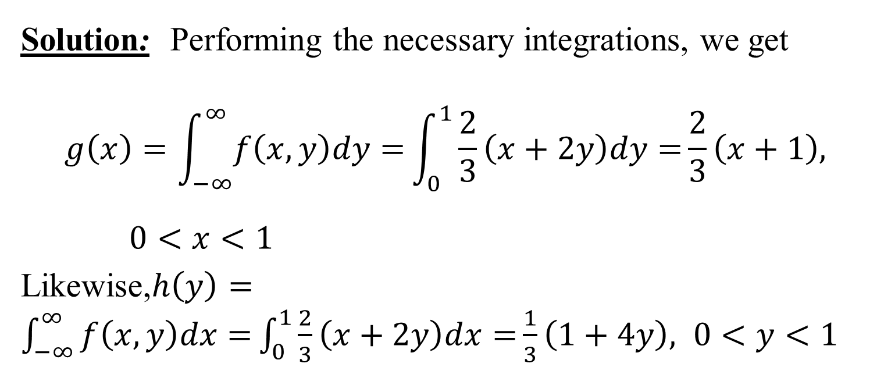
Solution: Performing the necessary integrations, we get
$$g\left(x\right)=\int_{−∞}^{∞}{f\left(x,y\right)dy=}\int_{0}^{1}{\frac{2}{3}\left(x+2y\right)dy=}\frac{2}{3}\left(x+1\right), 0<x<1$$
Likewise,$h\left(y\right)=\int_{−∞}^{∞}{f\left(x,y\right)dx=}\int_{0}^{1}{\frac{2}{3}\left(x+2y\right)dx=}\frac{1}{3}\left(1+4y\right), 0<y<1$

Slide 39
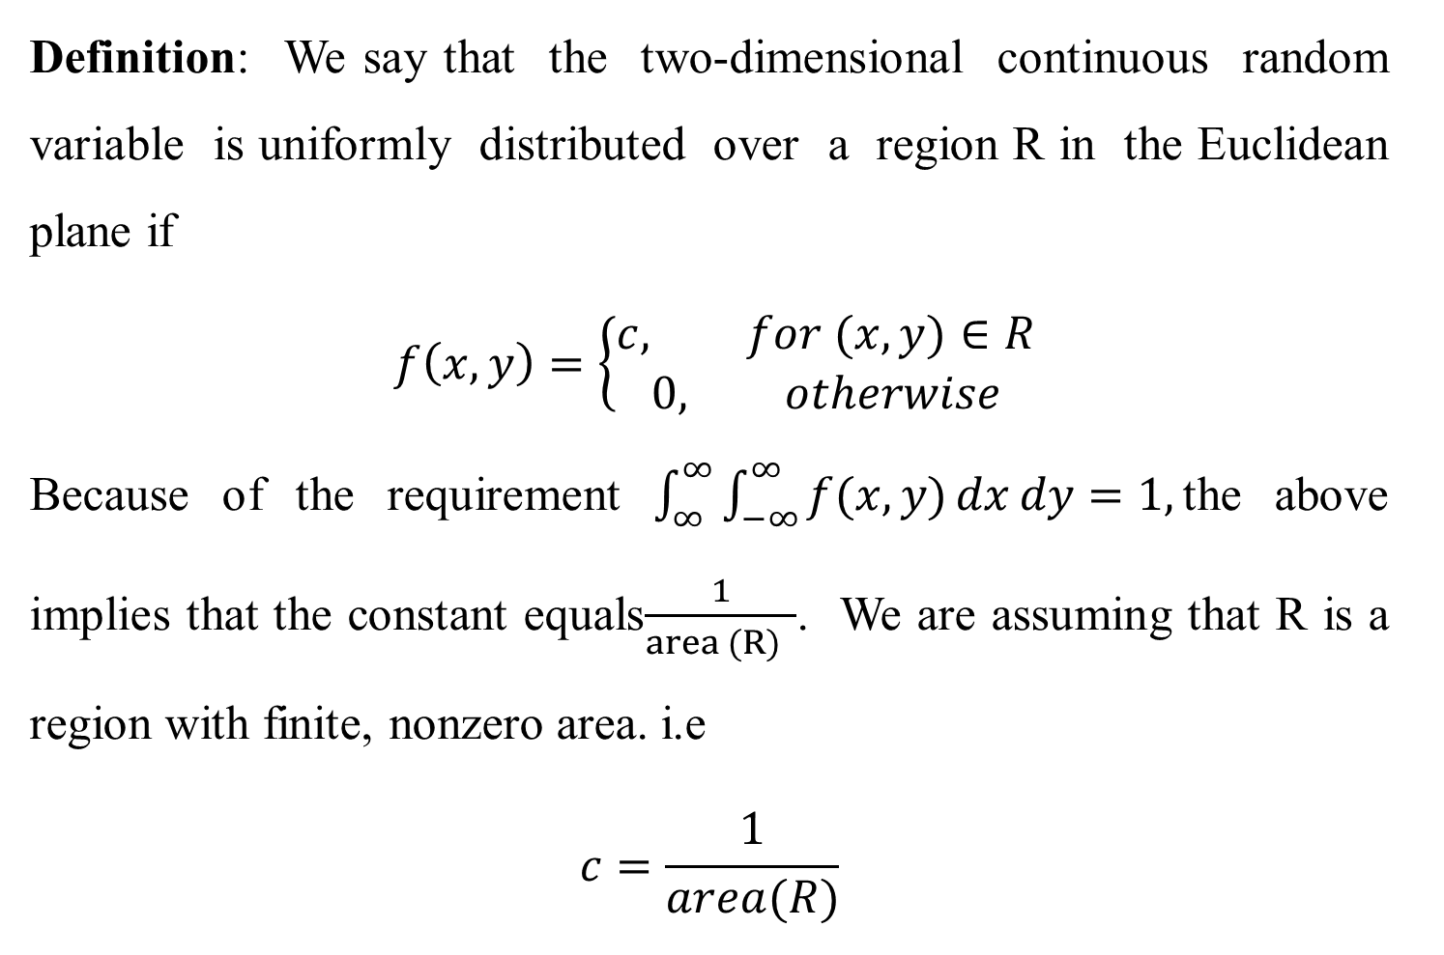
Definition: We say that the two-dimensional continuous random variable is uniformly distributed over a region R in the Euclidean plane if
$$f\left(x, y\right)=\left\{\begin{aligned}c, for (x,y)∈R \\ 0, otherwise\end{aligned}\right.$$
Because of the requirement $\int_{∞}^{∞}{\int_{−∞}^{∞}{f(x,y)}}dxdy=1,$the above implies that the constant equals$\frac{1}{area (R) }$. We are assuming that R is a region with finite, nonzero area. i.e
$$c=\frac{1}{area(R)}$$

Slide 40
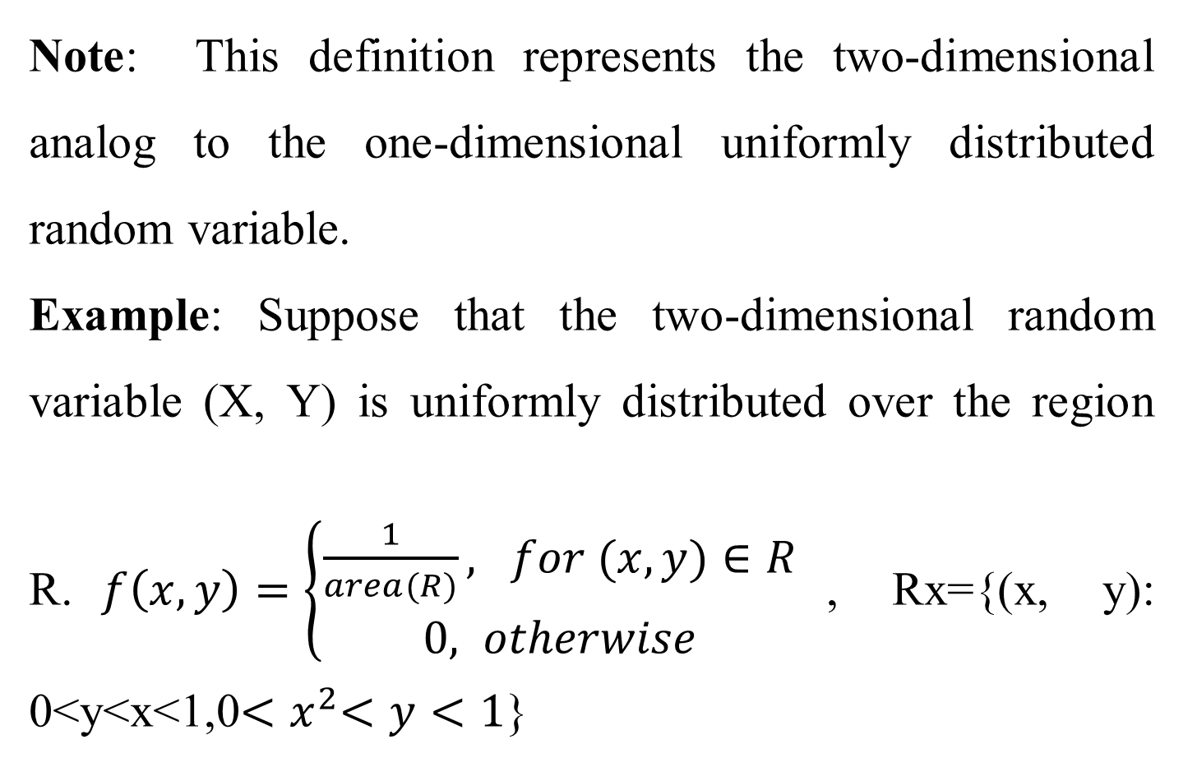
Note: This definition represents the two-dimensional analog to the one-dimensional uniformly distributed random variable.
Example: Suppose that the two-dimensional random variable (X, Y) is uniformly distributed over the region R.$f\left(x, y\right)=\left\{\begin{aligned}\frac{1}{area(R)}, for (x,y)∈R \\ 0, otherwise\end{aligned}\right.$, Rx={(x, y): 0<y<x<1,0${<x}^{2}<y<1$}

Slide 41
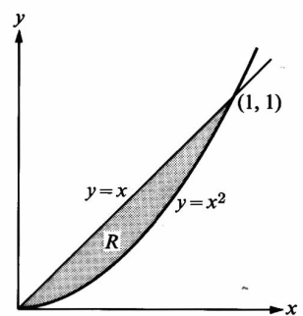
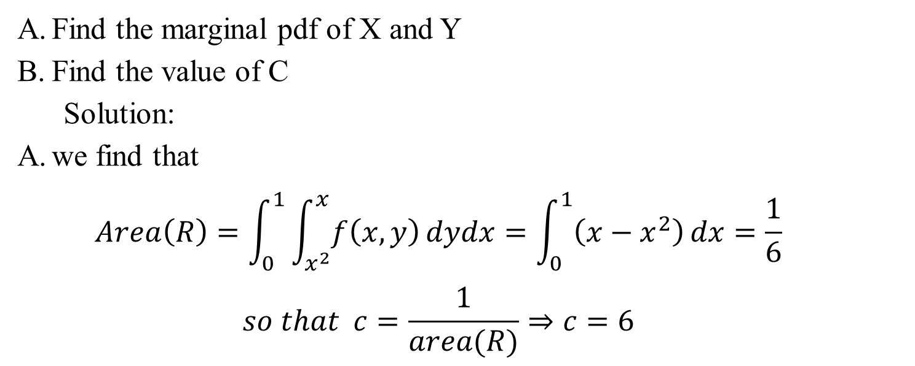
Find the marginal pdf of X and Y
Find the value of C
Solution:
we find that
$$Area\left(R\right)=\int_{0}^{1}{\int_{x^{2}}^{x}{f\left(x,y\right)}}dydx=\int_{0}^{1}{\left(x−x^{2}\right)dx=\frac{1}{6}}$$
$$so that c=\frac{1}{area(R)}⇒c=6$$

Slide 42
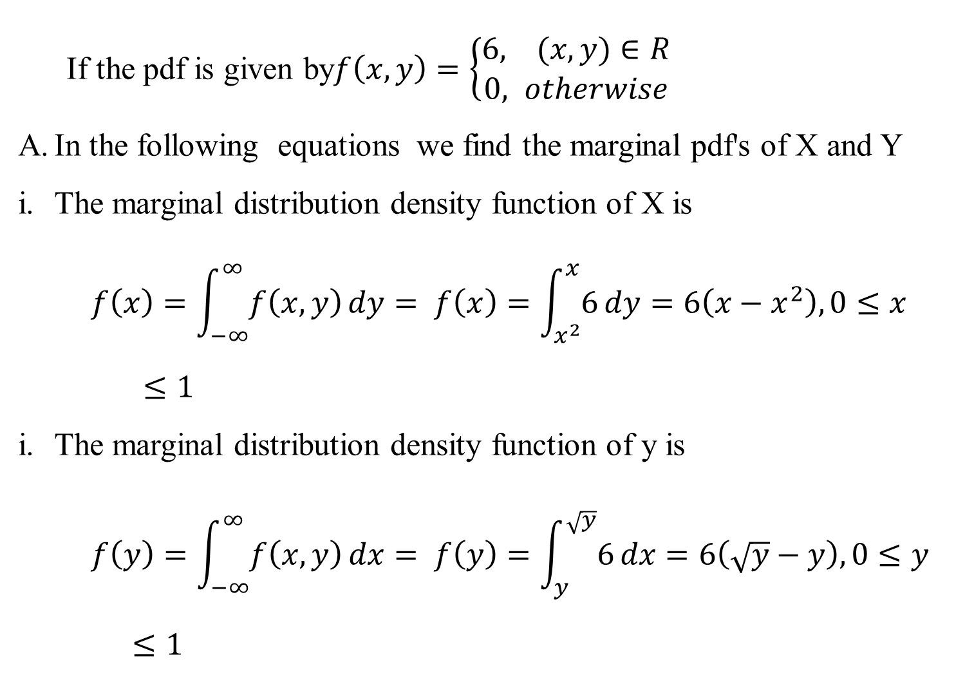
If the pdf is given by$f\left(x, y\right)=\left\{\begin{aligned}6, (x,y)∈R \\ 0, otherwise\end{aligned}\right.$
In the following equations we find the marginal pdf's of X and Y
The marginal distribution density function of X is
$$f\left(x\right)=\int_{−∞}^{∞}{f\left(x, y\right)dy}= f\left(x\right)=\int_{x^{2}}^{x}{6dy}=6\left(x−x^{2}\right),0≤x≤1$$
The marginal distribution density function of y is
$$f\left(y\right)=\int_{−∞}^{∞}{f\left(x, y\right)dx}= f\left(y\right)=\int_{y}^{\sqrt{y}}{6dx}=6\left(\sqrt{y}−y\right),0≤y≤1$$

Slide 43
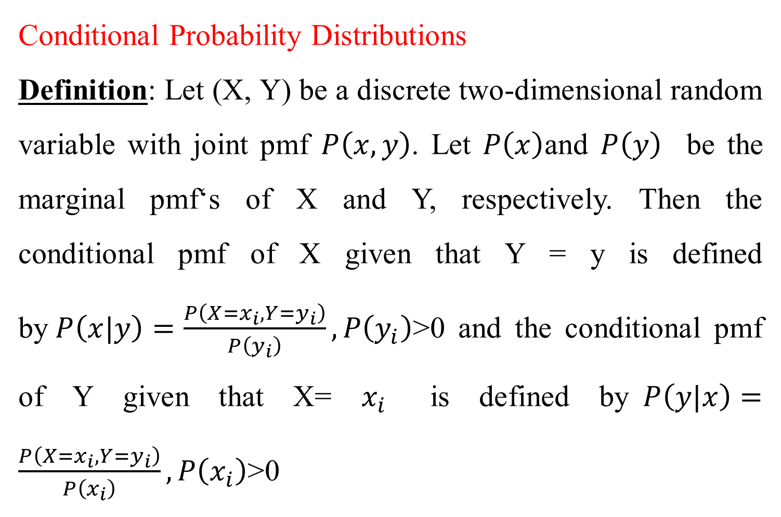
Conditional Probability Distributions
Definition: Let (X, Y) be a discrete two-dimensional random variable with joint pmf $P\left(x,y\right)$. Let $P\left(x\right)$and $P\left(y\right)$ be the marginal pmf‘s of X and Y, respectively. Then the conditional pmf of X given that Y = y is defined by$P\left(x|y\right)=\frac{P\left(X=x_{i},{Y=y}_{i}\right)}{P\left(y_{i}\right)},P\left(y_{i}\right)$>0 and the conditional pmf of Y given that X= $x_{i}$ is defined by$P\left(y|x\right)=\frac{P\left(X=x_{i},{Y=y}_{i}\right)}{P\left(x_{i}\right)},P\left(x_{i}\right)$>0

Slide 44
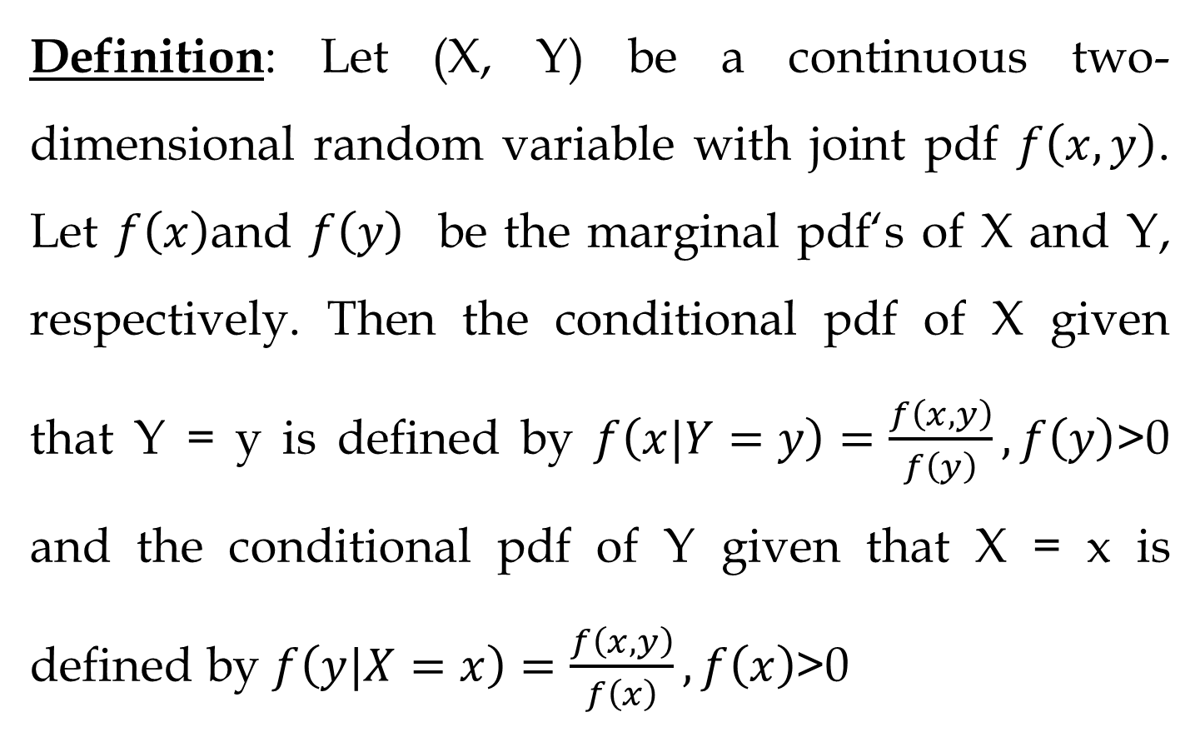
Definition: Let (X, Y) be a continuous two-dimensional random variable with joint pdf $f\left(x,y\right)$. Let $f\left(x\right)$and $f\left(y\right)$ be the marginal pdf‘s of X and Y, respectively. Then the conditional pdf of X given that Y = y is defined by $f\left(x|Y=y\right)=\frac{f\left(x,y\right)}{f\left(y\right)},f\left(y\right)$>0 and the conditional pdf of Y given that X = x is defined by $f\left(y|X=x\right)=\frac{f\left(x,y\right)}{f\left(x\right)},f\left(x\right)$>0

Slide 45
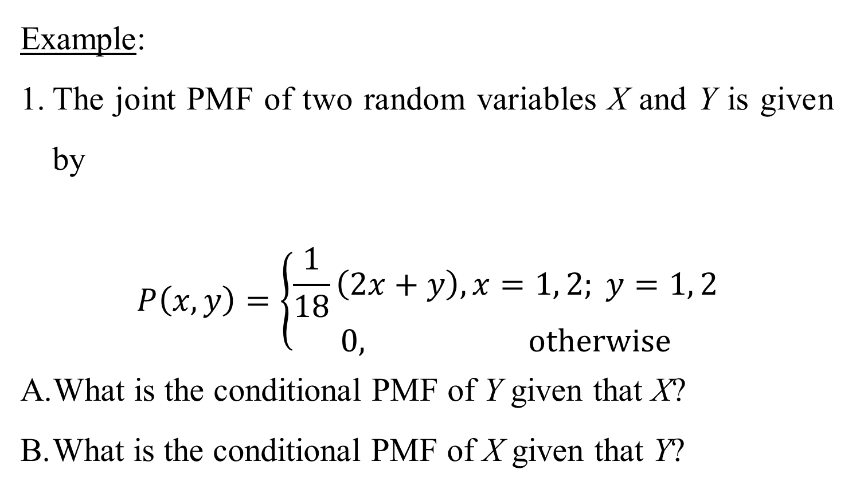
Example:
The joint PMF of two random variables X and Y is given by
$$P\left(x, y\right)=\left\{\begin{aligned}\frac{1}{18}\left(2x+y\right), x=1, 2; y=1, 2 \\ 0, otherwise\end{aligned}\right.$$
What is the conditional PMF of Y given that X?
What is the conditional PMF of X given that Y?

Slide 46
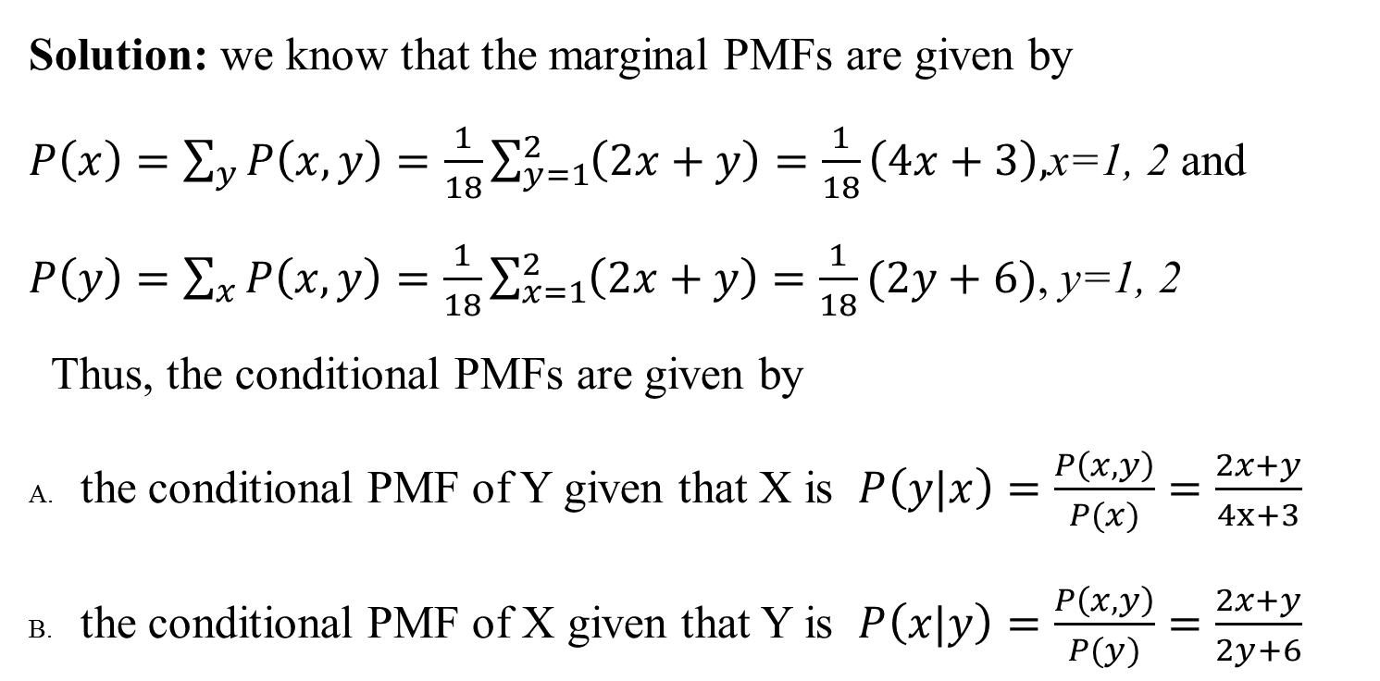
Solution: we know that the marginal PMFs are given by
$P\left(x\right)=\sum_{y}{P\left(x, y\right)}=\frac{1}{18}\sum_{y=1}^{2}{\left(2x+y\right)}=\frac{1}{18}\left(4x+3\right),$x=1, 2 and
$P\left(y\right)=\sum_{x}{P\left(x, y\right)}=\frac{1}{18}\sum_{x=1}^{2}{\left(2x+y\right)}=\frac{1}{18}(2y+6)$, y=1, 2
Thus, the conditional PMFs are given by
the conditional PMF of Y given that X is $P\left(y|x\right)=\frac{P\left(x, y\right)}{P(x)}=\frac{2x+y}{4x+3}$
the conditional PMF of X given that Y is $P\left(x|y\right)=\frac{P\left(x, y\right)}{P(y)}=\frac{2x+y}{2y+6}$

Slide 47
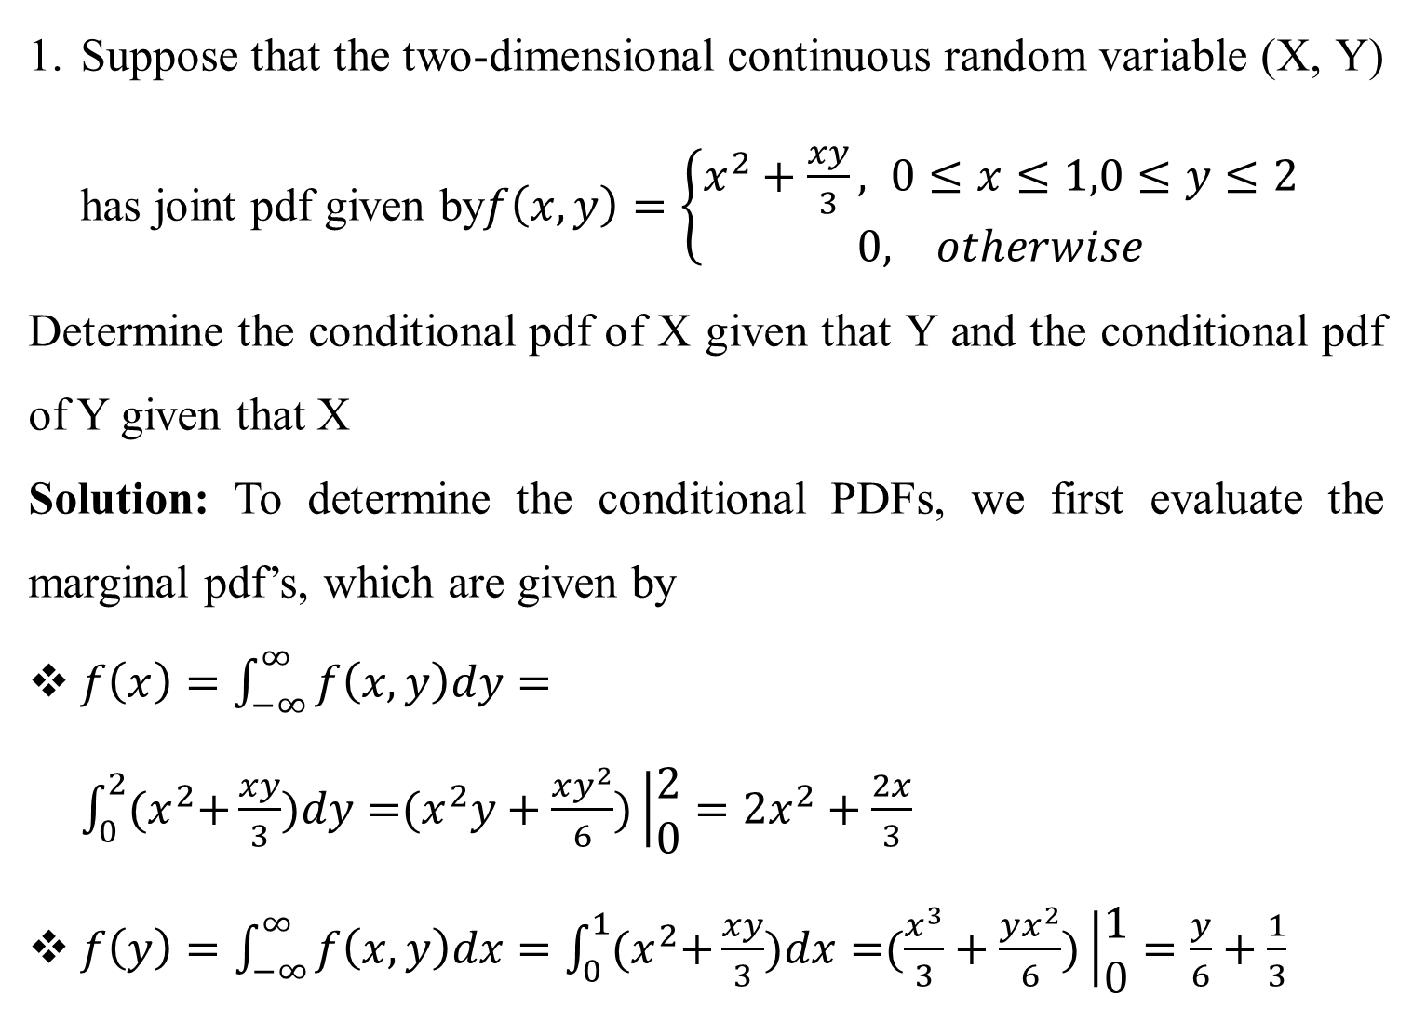
Suppose that the two-dimensional continuous random variable (X, Y) has joint pdf given by$f\left(x, y\right)=\left\{\begin{aligned}x^{2}+\frac{xy}{3}, 0≤&x≤1,0≤y≤2 \\ 0, otherwise\end{aligned}\right.$
Determine the conditional pdf of X given that Y and the conditional pdf of Y given that X
Solution: To determine the conditional PDFs, we first evaluate the marginal pdf’s, which are given by
$f\left(x\right)=\int_{−∞}^{∞}{f\left(x, y\right)dy}=\int_{0}^{2}{{(x}^{2}+\frac{xy}{3})dy={(x}^{2}y+\frac{xy^{2}}{6})\left|\begin{aligned}2 \\ 0\end{aligned}={2x}^{2}+\frac{2x}{3}\right.}$
$f\left(y\right)=\int_{−∞}^{∞}{f\left(x, y\right)dx}=\int_{0}^{1}{{(x}^{2}+\frac{xy}{3})dx=(\frac{x^{3}}{3}+\frac{yx^{2}}{6})\left|\begin{aligned}1 \\ 0\end{aligned}=\frac{y}{6}+\frac{1}{3}\right.}$

Slide 48
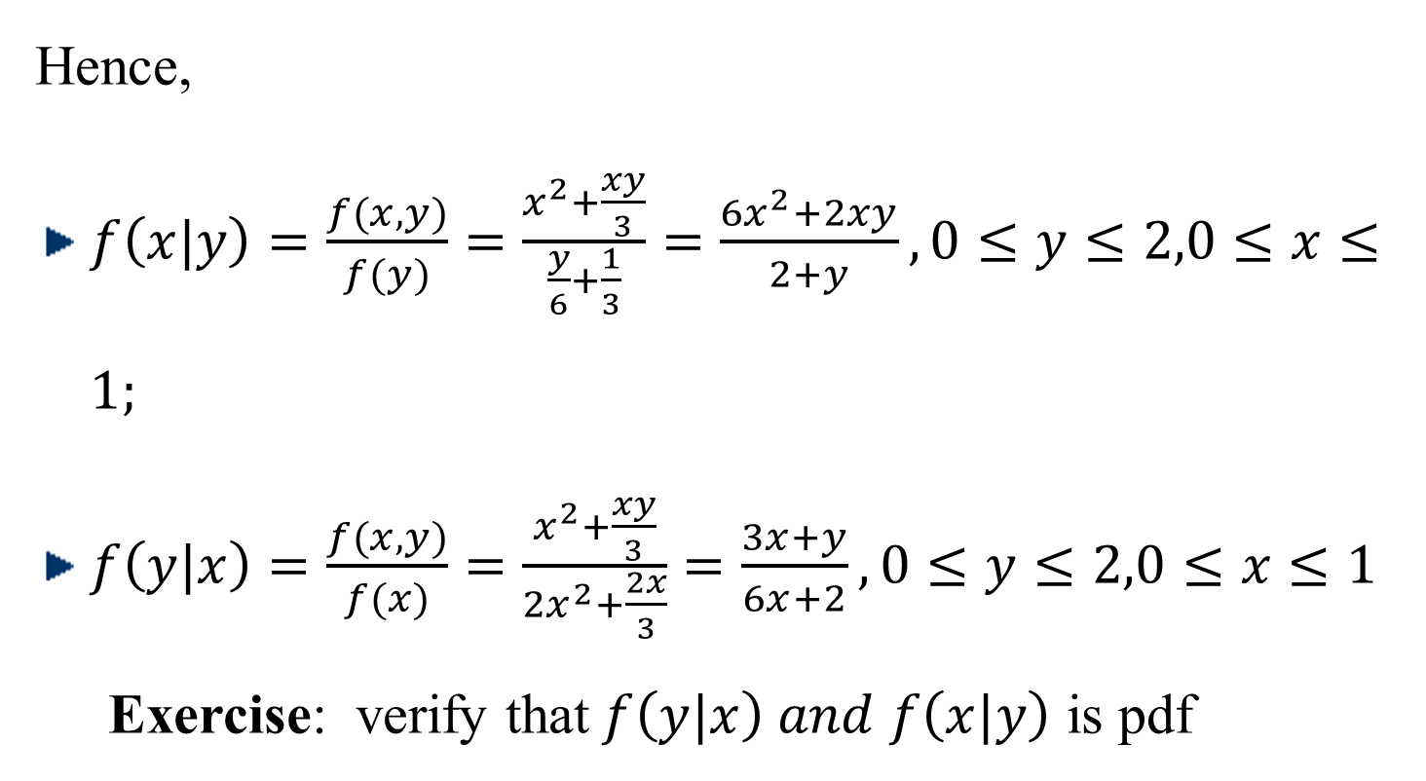
Hence,
$f\left(x|y\right)=\frac{f(x,y)}{f(y)}=\frac{x^{2}+\frac{xy}{3}}{\frac{y}{6}+\frac{1}{3}}=\frac{{6x}^{2}+2xy}{2+y},0≤y≤2,0≤x≤1;$
$f\left(y|x\right)=\frac{f(x,y)}{f(x)}=\frac{x^{2}+\frac{xy}{3}}{{2x}^{2}+\frac{2x}{3}}=\frac{3x+y}{6x+2},0≤y≤2,0≤x≤1$
Exercise: verify that$f\left(y|x\right) and f\left(x|y\right)$ is pdf

Slide 49
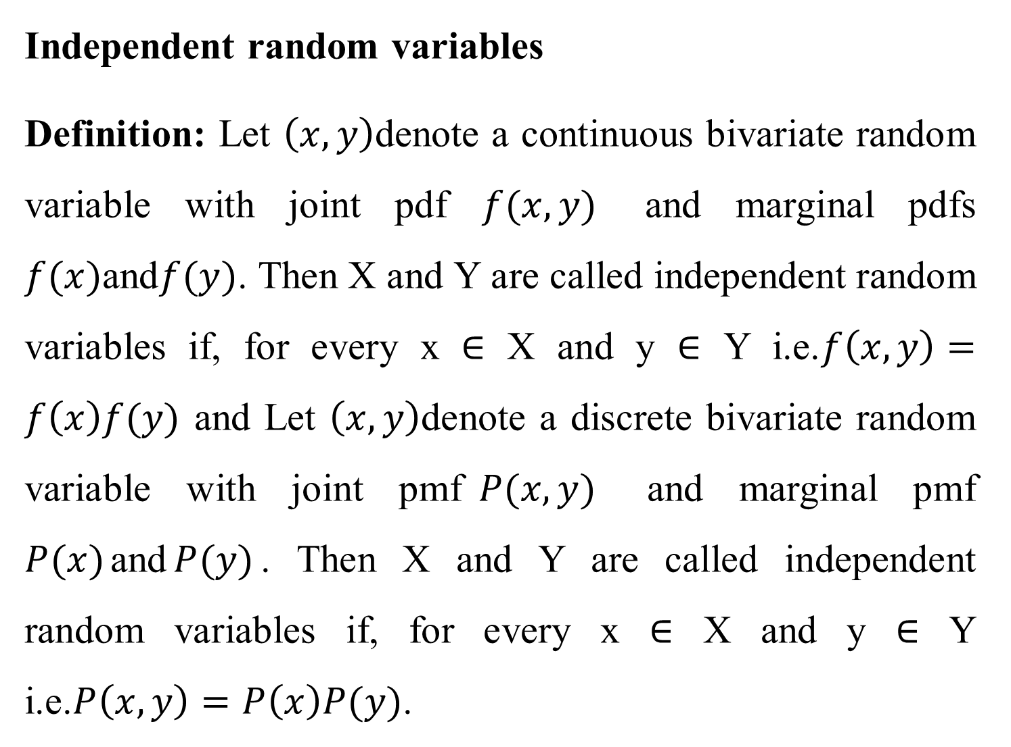
Independent random variables
Definition: Let $\left(x, y\right)$denote a continuous bivariate random variable with joint pdf $f(x, y)$ and marginal pdfs $f(x)$and$f(y)$. Then X and Y are called independent random variables if, for every x ∈ X and y ∈ Y i.e.$f\left(x, y\right)=f\left(x\right)f(y)$ and Let $\left(x, y\right)$denote a discrete bivariate random variable with joint pmf$P(x, y)$ and marginal pmf $P(x)$and$P(y)$. Then X and Y are called independent random variables if, for every x ∈ X and y ∈ Y i.e.$P\left(x, y\right)=P\left(x\right)P(y)$.

Slide 50
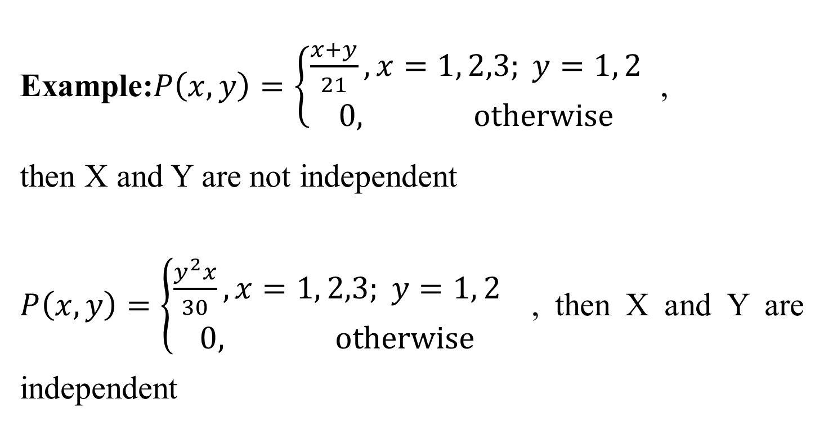
Example:$P\left(x, y\right)=\left\{\begin{aligned}\frac{x+y}{21}, x=1, 2,3; y=1, 2 \\ 0, otherwise\end{aligned}\right.$ ,
then X and Y are not independent
$P\left(x, y\right)=\left\{\begin{aligned}\frac{y^{2}x}{30}, x=1, 2,3; y=1, 2 \\ 0, otherwise\end{aligned}\right.$ , then X and Y are independent

Slide 51
Suppose (X, Y) are discrete random variables with probability function given by
Y x | -1 | 0 | 1 | P_{x}(x)
-1 | 1/8 | 1/8 | 1/8
0 | 1/8 | 0 | 1/8
1 | 1/8 | 1/8 | 1/8
P_{Y}(y)
find the marginal pmf of X and Y
Are X and Y independent?

Slide 52
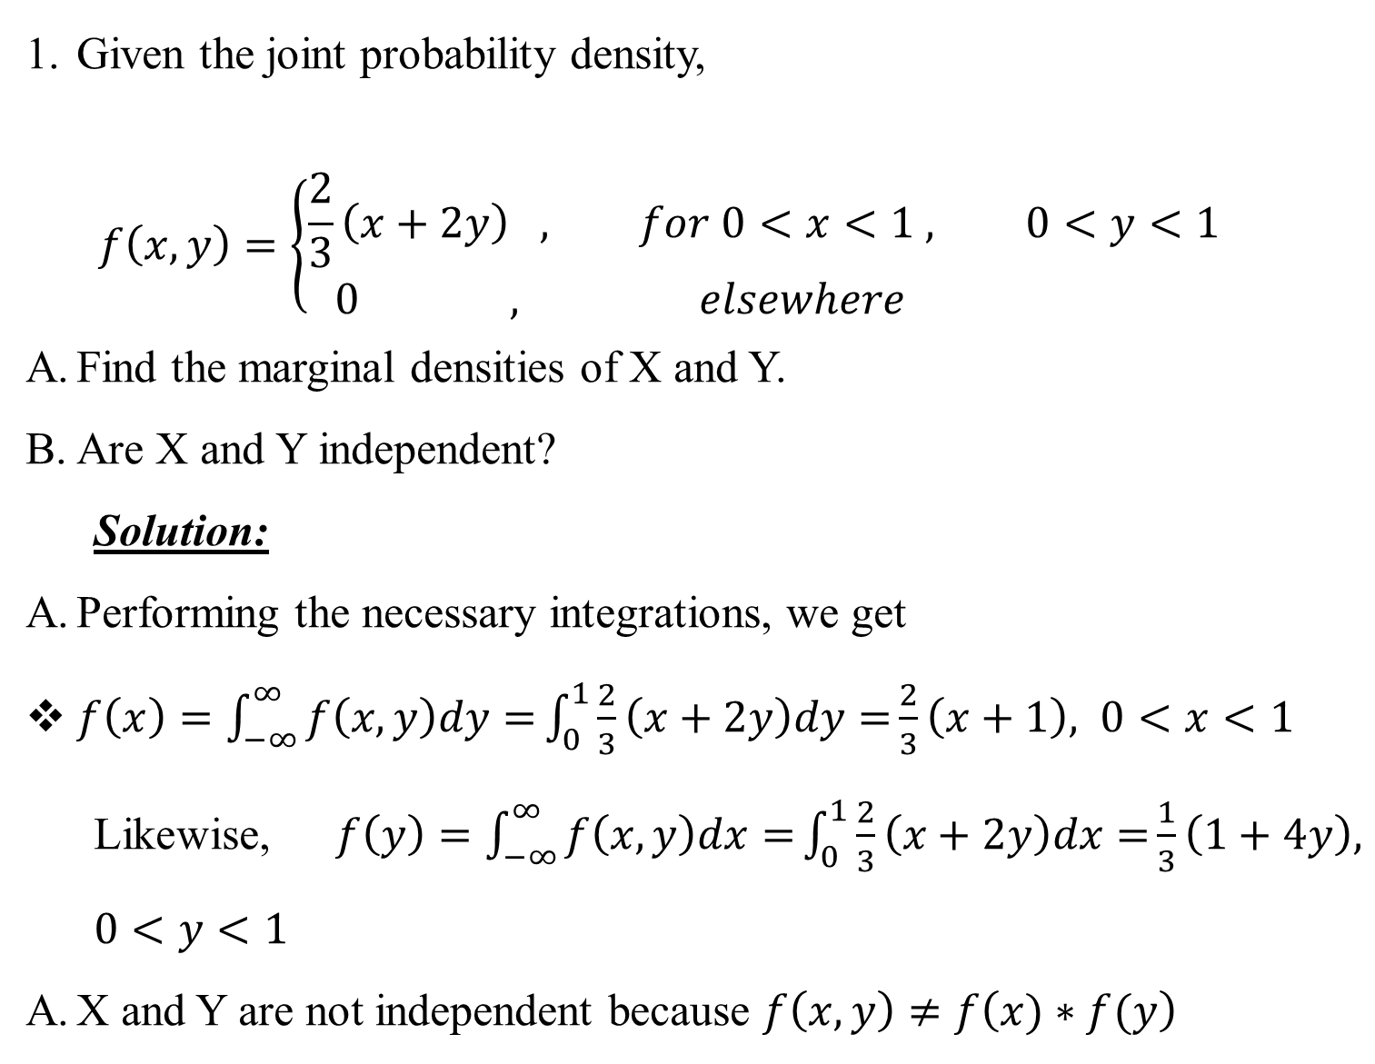
Given the joint probability density,
$$f\left(x,y\right)=\left\{\begin{aligned}\frac{2}{3}\left(x+2y\right) , for 0<x<1 , 0<y<1 \\ 0 , elsewhere \end{aligned}\right.$$
Find the marginal densities of X and Y.
Are X and Y independent?
Solution:
Performing the necessary integrations, we get
$f\left(x\right)=\int_{−∞}^{∞}{f\left(x,y\right)dy=}\int_{0}^{1}{\frac{2}{3}\left(x+2y\right)dy=}\frac{2}{3}\left(x+1\right), 0<x<1$
Likewise, $f\left(y\right)=\int_{−∞}^{∞}{f\left(x,y\right)dx=}\int_{0}^{1}{\frac{2}{3}\left(x+2y\right)dx=}\frac{1}{3}\left(1+4y\right), 0<y<1$
X and Y are not independent because $f\left(x,y\right)≠f\left(x)∗f(y\right)$

Slide 53
CHAPTER-SEVEN
EXPECTATION
Expectation of a Random Variable
The averaging process, when applied to a random variable is called expectation. It is denoted by E(X) or μand is read as the expected value of X or the mean value of X.

Slide 54
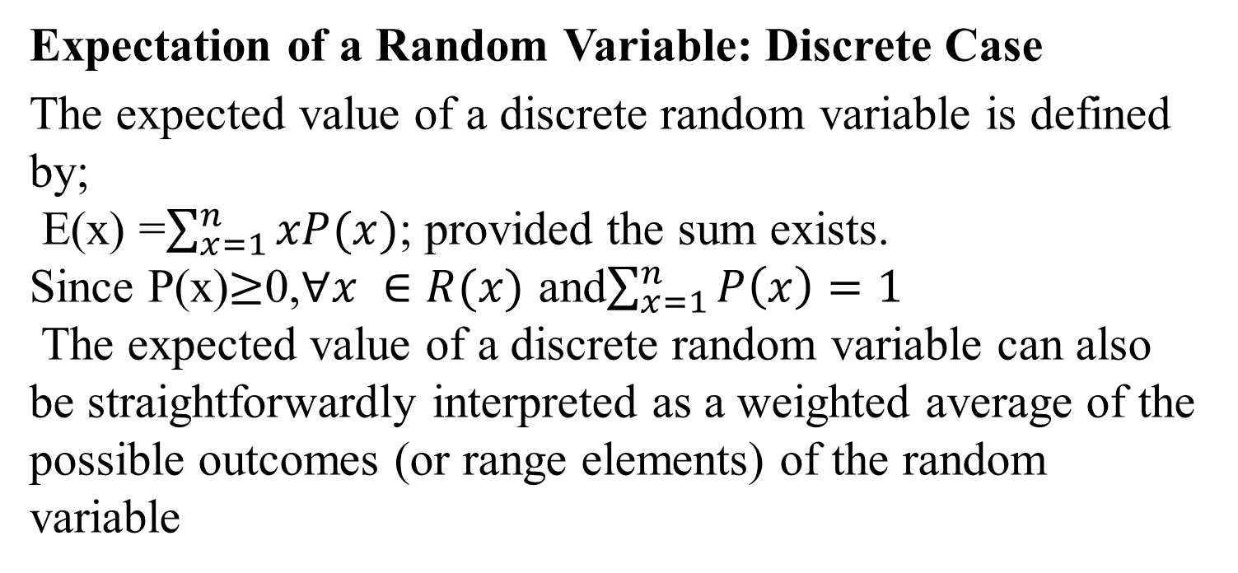
Expectation of a Random Variable: Discrete Case
The expected value of a discrete random variable is defined by;
E(x) =$\sum_{x=1}^{n}{xP(x)}$; provided the sum exists.
Since P(x)$≥$0,$∀x ∈R(x)$ and$\sum_{x=1}^{n}{P\left(x\right)=1}$
The expected value of a discrete random variable can also be straightforwardly interpreted as a weighted average of the possible outcomes (or range elements) of the random variable
Example 1: Consider the random variable representing the number of episodes of diarrhea in the first 2 years of life. Suppose this random variable has a probability mass function as below

Slide 55
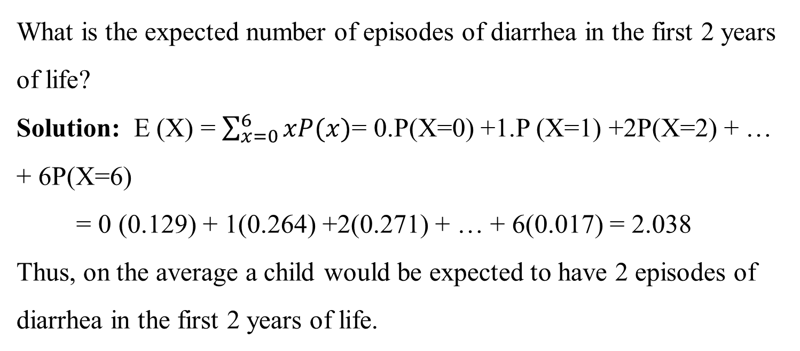
X | 0 | 1 | 2 | 3 | 4 | 5 | 6
P(X = x) | 0.129 | 0.264 | 0.271 | 0.185 | 0.095 | 0.039 | 0.017
What is the expected number of episodes of diarrhea in the first 2 years of life?
Solution: E (X) = $\sum_{x=0}^{6}{xP(x)}$= 0.P(X=0) +1.P (X=1) +2P(X=2) + … + 6P(X=6)
= 0 (0.129) + 1(0.264) +2(0.271) + … + 6(0.017) = 2.038
Thus, on the average a child would be expected to have 2 episodes of diarrhea in the first 2 years of life.

Slide 56
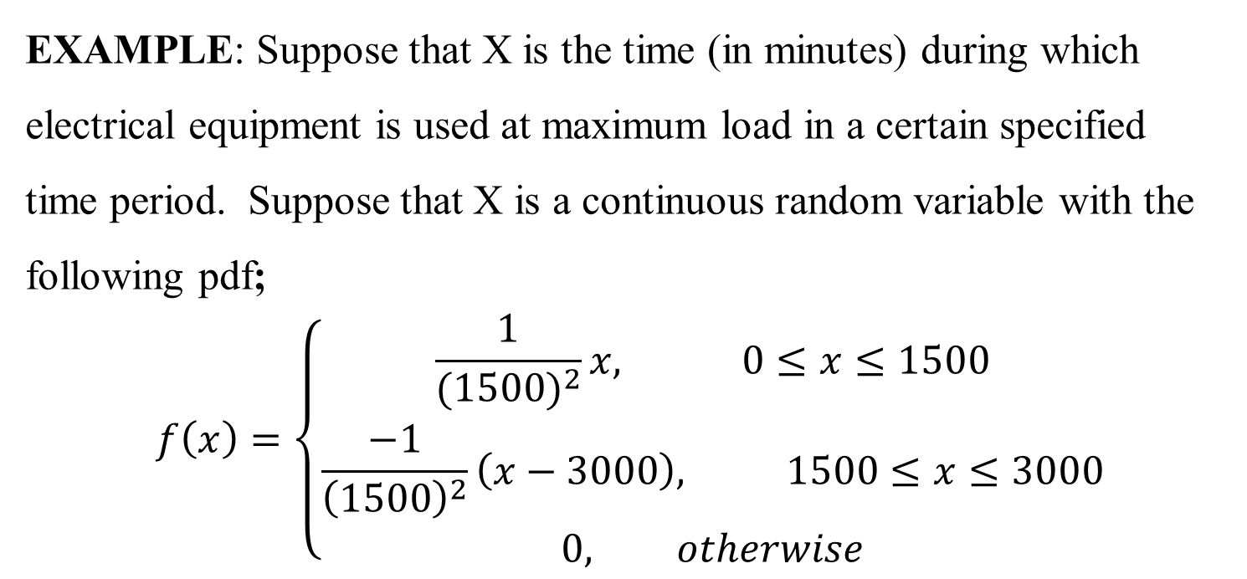

Expected Value of a Random Variable: Continuous Case
The expected value of the continuous random variableXis defined by
E(x)$=\int_{−∞}^{+∞}{xf\left(x\right)dx}$, provided the integral exists.
EXAMPLE: Suppose that X is the time (in minutes) during which electrical equipment is used at maximum load in a certain specified time period. Suppose that X is a continuous random variable with the following pdf;
$$f\left(x\right)=\left\{\begin{aligned}\frac{1}{{(1500)}^{2}}x, 0≤x≤1500 \\ \frac{−1}{{\left(1500\right)}^{2}}\left(x−3000\right), 1500≤x≤3000 \\ 0, otherwise\end{aligned}\right.$$

Slide 57

Solution: By definition, E(x)=$\int_{−∞}^{+∞}{xf\left(x\right)dx}$
$$E(x)=\int_{−∞}^{+∞}{xf\left(x\right)dx}=\int_{0}^{1500}{xf\left(x\right)dx}+\int_{1500}^{3000}{xf\left(x\right)dx}=\int_{0}^{1500}{x\frac{1}{{\left(1500\right)}^{2}}xdx}+\int_{1500}^{3000}{x\frac{−1}{{\left(1500\right)}^{2}}\left(x−3000\right)dx}$$
$$=\frac{1}{{(1500)}^{2}}\int_{0}^{1500}{x^{2}dx}−\frac{1}{{(1500)}^{2}}\int_{1500}^{3000}{x\left(x−3000\right)dx}$$
$$=\frac{1}{{\left(1500\right)}^{2}}\frac{x^{3}}{3}\left|\begin{aligned}1500 \\ 0\end{aligned}\right.−\frac{1}{{\left(1500\right)}^{2}}\left(\frac{x^{3}}{3}−3000\frac{x^{2}}{2}\right)\left|\begin{aligned}3000 \\ 1500\end{aligned}\right.$$
=1500 minutes

Slide 58

Example: A large domestic automobile manufacturer mails out quarterly customer satisfaction surveys to owners who have purchased new automobiles within the last 3 years. The proportion of surveys returned in any given quarter is the outcome of a random variable X having density function$f\left(x\right)=\left\{\begin{aligned}3x^{2},0≤x≤1 \\ 0, &otherwise\end{aligned}\right.$. What is the expected proportion of surveys returned in any given quarter?

Slide 59

Solution: By definition,
E(x) =$\int_{−∞}^{+∞}{xf\left(x\right)dx}$=$\int_{0}^{1}{x(3x^{2})dx}$=$\int_{0}^{1}{3x^{3}dx}$=$\frac{3x^{4}}{4}\left|\begin{aligned}1 \\ 0\end{aligned}\right.$= 0.75
The expected proportion of surveys returned in any given quarter is 0.75
Expectations of Functions of Random Variables
Let X be a random variable having density function f(x).Then the expectation of
Y=g(x) is given by E(Y)=$\left\{\begin{aligned}\sum_{x=1}^{n}{g\left(x\right)P\left(x\right)},if x is discrete random variable \\ \int_{−∞}^{+∞}{g(x)f\left(x\right)dx},if x is continuous random variable\end{aligned}\right.$

Slide 60
Properties of Expectation
If X and Y are random variables and a, b are constants then:
E(k) = k, where k is any constant
E (kX) = k E(X), where k is any constant
E (X + k) =E(X) + k
E(X + Y) = E(X) +E(Y)
E(X) ≥ 0, if X ≥ 0.
|E(X)| ≤ E(|X|)
|E(XY)²| ≤ E(X²) E(Y²).
E(XY) = E(X) E(Y), if X, Y are independent random variables

Slide 61

Example:
A small rural bank has two branches located in neighboring towns in East Gojjam. The numbers of certificates of deposit that are sold at the branch in Menkorere and the branch in Gozamen in any given week can be viewed as the outcome of the bivariate random variable (X,Y) having joint probability density function
$$P\left(x,y\right)=\left\{\begin{aligned}\frac{x^{2}y}{30}, y=1,2,3 &and x=1,2 \\ 0, otherwise\end{aligned}\right.$$
Are the random variables independent?
What is the expected number of certificate sales by the Gozamen Branch?
What is the expected number of combined certificate sales for both branches?

Slide 62

Theorem: Let (X, Y) be a two-dimensional random variable and suppose that X and Yare independent. Then E(XY) = E(X)E(Y).
Proof:

Slide 63


Variance of random variable
The variance of a random variable measures the variability of the random variable about its expected value.
Definition: Let X be a random variable. We define the variance of X, denoted by V(X) or ${σ_{x}}^{2}$, as follows:
Mean of X = E(X)
Variance of X =${σ_{x}}^{2}=E\left(X^{2}\right)−{[E\left(X\right)]}^{2}$ = ${E[X−E(X)]}^{2}$
The positive square root of V(X) is called the standard deviation of X and is denoted by ${σ_{x}}_{}$

Slide 64

Proof: Expanding E(x-E(x))2 and using the previously established properties for expectation, we obtain

Slide 65

Case 1: Variance for discrete random variable
If X is a discrete random variable with expected value μ then the variance of X, denoted by Var (X), is defined by:
${σ_{x}}^{2}=$Var(X) = E(X-μ)² = E(X²) – μ²= $\sum_{i=1}^{n}{{x_{i}}^{2}}P\left({(x}_{i}\right)−μ^{2}$
Alternatively, Var(X) = $\sum_{i=1}^{n}{{{(x}_{i}−μ_{x})}^{2}P\left(x_{i}\right)}$

Slide 66

Case 2: Variance for continuous random variable
If X is a continuous random variable, then var (X), ${σ_{x}}^{2}=\int_{−∞}^{∞}{{\left(x−\overline{x}\right)}^{2}}f_{x}(x)dx$
Properties of Variances
For any random variable X and Y and constant a and b, it can be shown that
$Var(ax+b)=a^{2}var(x)$
$Var\left(ax+by\right)=a^{2}var\left(x\right)+b^{2}Var\left(y\right)+2abCov\left(x,y\right)$
$Var\left(ax−by\right)=a^{2}var\left(x\right)+b^{2}Var\left(y\right)−2abCov\left(x,y\right)$
if X₁, X₂ ……, X_{n} are independent random variables, then
$Var\left(X1+X2+…+Xn\right)=var\left(x1\right)+Var (X2) +…+ var (Xn$)

Slide 67

i.e.,$Var\left(\sum_{i=1}^{k}{x_{i}}\right)=\sum_{i=1}^{k}{Var(x_{i})}$
$$\left.\begin{aligned}Var\left(x+y\right)=Var\left(x\right)+Var(y) \\ \left(Var\left(x−y\right)=Var\left(x\right)+Var(y)\right)\end{aligned}\right\}$$
$$when X and Y are independent$$
$$\left.\begin{aligned}Var\left(x+y\right)=Var\left(x\right)+Var\left(y\right)+2Cov\left(x,y\right) \\ Var\left(x−y\right)=Var\left(x\right)+Var\left(y\right)−2Cov(x,y)\end{aligned}\right\}$$
$$when X and Y are not independent$$

Slide 68

V(x) = E(x²) – [E(x)]²
$$E\left(x^{2}\right)=\int_{−∞}^{+∞}{x^{2}f(x)dx}=\int_{−∞}^{+∞}{x^{2}∗\frac{x^{2}}{9}dx}=\int_{−∞}^{+∞}{\frac{x^{4}}{9}dx}=\frac{1}{9}[\frac{x^{5}}{5}]\left|\begin{aligned}3 \\ 0\end{aligned}=\frac{27}{5}\right.$$
$$E\left(x\right)=\int_{−∞}^{+∞}{xf(x)dx}=\int_{−∞}^{+∞}{x∗\frac{x^{2}}{9}dx}=\int_{−∞}^{+∞}{\frac{x^{3}}{9}dx}=\frac{1}{9}[\frac{x^{4}}{4}]\left|\begin{aligned}3 \\ 0\end{aligned}=\frac{9}{4}\right.$$
Therefore, V(x) = E(x²) – [E(x)]²
$=\frac{27}{5}+({\frac{9}{4})}^{2}=\frac{27}{80}=0.3375≈0.34$

Slide 69

Covariance and Correlation coefficient
Covariance: The central joint moment $μ_{1,1}$=$E(x−E\left(x\right)E(y−E\left(y\right))$ is called the covariance between XandY, and is denoted by the symbol${ σ}_{xy}$, or by$cov\left(x,y\right)$.
Note that there is a simple relationship between${ σ}_{xy}$ and moments about the origin that can be used for the calculation of the covariance.
$$σ_{xy}=E\left(xy\right)−E\left(x\right)E(y)$$

Slide 70

Example: Let the bivariate random variable (X,Y) have a joint density function
$f\left(x,y\right)=\left\{\begin{aligned}x+y, &0<x<1,0<y<1 \\ 0, &otherwise\end{aligned}\right.$ Find$cov\left(x,y\right)$.

Slide 71

Solution: from the definition of covariance it is computed as Cov(x,y)=Exy-E(x)E(y)
Therefore by the definition of covariance
Cov(x,y)=Exy-E(x)E(y) =13-712*712=-1144

Slide 73

Example: Let X and Y be two random variables having a joint density function given by
$f\left(x,y\right)=\left\{\begin{aligned}1.5, &−1<x<1,0<y<x^{2} \\ 0, &otherwise\end{aligned}\right.$.
Note this density implies that (x,y) points are equally likely to occur on and below the parabola represented by the graph of${ y=x}^{2}$. There is a direct functional dependence between Xand the range ofY, so that$f\left(x|y\right)$will change as x changes and thus XandY must be dependent random variables. Nonetheless;${ σ}_{xy}=0$. To see this, note that

Slide 74

So that the X and Y are independent random variable

Slide 75

Properties of covariance:
If X and Y are either continuos or discrete random variable and if a and b are any constant number, then covariance has the following properties.
$Cov\left(x,y\right)=E\left(xy\right)−E\left(x\right)E\left(y\right)$
$Cov\left(x,y\right)=0,if X and Y are independent$
$Corr\left(x,y\right)=0,if X and Y are independent$
$Cov\left(x,x\right)=Var\left(x\right)$
$Cov\left(x+a,y\right)=Cov\left(x,y\right)$
$Cov\left(ax,y\right)=aCov\left(x,y\right)$
$Cov\left(x,y+z\right)=Cov\left(x,y\right)+Cov\left(x,z\right)$
$Cov\left(ax,by\right)=abCov\left(x,y\right)$
$Cov\left(x±a,y±b\right)=Cov\left(x,y\right)$

Slide 76

Correlation coefficient: The correlation coefficient between two random variables X and Y is defined by$corr\left(x,y\right)=ρ_{xy}=\frac{σ_{xy}}{σ_{x}σ_{y}}$
Correlation coefficient tells us the degree of association and the direction of the linear relationship between the random variables.
The correlation coefficient computed from the sample data measures the strength and direction of a linear relationship between two variables.
The symbol for the sample correlation coefficient is r.
The symbol for the population correlation coefficient is ρ
The range of the correlation coefficient is from −1 to +1.

Slide 77

If there is a strong positive linear relationship between the variables, the value of r will be close to +1.
If there is a strong negative linear relationship between the variables, the value of r will be close to −1.
When there is no linear relationship between the variables or only a weak relationship, the value of r will be close to 0.
Example: Let the bivariate random variable (X,Y) have a joint density function
$f\left(x,y\right)=\left\{\begin{aligned}x+y, &0<x<1,0<y<1 \\ 0, &otherwise\end{aligned}\right.$, then compute the correlation coefficient of X and Y?

Slide 78
Solution:

Slide 79


Slide 80
Properties of correlation: Let X and Y be random variables with correlation equal to ρ.Then-1≤ ρ ≤1. Furthermore, ρ equals 1 or -1 if and only if Y is a linear function of X. In fact:
If Y = a +bX for some constants a and b then ρ=1 if b>0, and ρ=-1 if b<0.
If Y ≠ a +bX for all a and b then -1< ρ<1.
If X and Y are independent then ρ=0
Exercise:

Slide 81

A Seattle newspaper intends to administer two different surveys relating to two different anti-tax initiatives on the ballot in November. The proportion of surveys mailed that will actually be completed and returned to the newspaper can be represented as the outcome of a bivariate random variable (X,Y) having the density function
$$f\left(x,y\right)=\left\{\begin{aligned}\frac{2}{5}\left(x+2y\right), 0<&x<1,0<&x<1 \\ 0, &otherwise\end{aligned}\right.$$
Where X is the proportion of surveys relating to initiative I that are returned, and Y refers to the proportion of surveys relating to initiative II that are returned.
Compute the covariance and correlation coefficient between the X and Y and also interpret the values of correlation coefficient between the X and Y

Slide 83
Debremarkos University College of natural and computational Sciences Department of Statistics Probability Distributions

Slide 84
Objectives
After studying this chapter, you should be able to:
Distinguish between Discrete random variables from continuous random variables.
Find the expected value and standard deviation of discrete probability distribution.
Calculate probability problems by applying definition of probability.
Apply expected value in decision making.

Slide 85
Introduction to basic terms
Variable: - Is any characteristic or attribute that can assume different values.
A random variable is a variable whose values are determined by chance.
It is a function which associates a number (real number) to each possible outcome of an experiment

Slide 86
Introduction to basic terms………
E.g.1: suppose a coin is tossed three times. Let X be the number of heads.
Solution: If we toss a coin three times, then the experiment has a total of eight possible outcomes,: S= {HHH, HHT, HTH, THH, HTT, THT, TTH, TTT}.
Since X is the characteristic, which denotes the number of heads out of the three tosses
X is a function defined on the elements of S and the possible values of X are {0, 1, 2, and 3}.
Specifically X(HHH)=3, X(HHT)=X(HTH)=X(THH)=2, X(HTT)=X(THT)=X(TTH)=1, X(TTT)=0

Slide 87
Introduction to basic terms………
Discrete Random variable – let x be a r.v. If the number of possible values of x is finite or countable infinite, we call x a discrete r.v
The possible values of x can be listed as x₁, x₂, x₃… x_{n}
Let x be discrete r.v with each possible outcome x, we associate a number
P (x_{i}) = P (X=x_{i}) called the probability of x.

Slide 88

Introduction to basic terms………

Slide 89

Introduction to basic terms………

Slide 90
Expectation, Mean and Variance of a random variable
Expectation: The averaging process, when applied to a random variable is called expectation. It is denoted by E(X) and is read as the expected value of X or the mean value of X.

Slide 91

Expectation

Slide 92

Expectation………

Slide 93
Expectation………
Properties of Expectation
If X and Y are random variables and a, b are constants then:
1. E (a) = a
2. E (a X) = a E(X)
3. E (a X + b) = a E(X) + b
4. E (X + a) =E(X) + a
5. E(X + Y)= E(X) +E(Y)
6. E(XY) = E(X) E(Y), if X, Y are independent random variables

Slide 94

Expectation………

Slide 95

Variance of a random variable

Slide 96

Variance of a random variable………

Slide 97
Common discrete distributions

Slide 98
Probability distribution
Every random variable has a corresponding probability distribution.
and probability distribution or just distribution refers to the way data are distributed, in order to draw conclusions about a set of data.
It also refers to the underlying, usually unknown, distribution of the population or random variable.
The probability distribution of a categorical variable tells us with what probability the variable will take on the different possible values (outcomes).

Slide 99
Binomial distribution
A binomial experiment is a probability experiment that satisfy the following four requirements
There must be a fixed number of trials called n
Each trial can have only two outcomes or outcomes that can be reduced to two outcomes. These outcomes can be considered ether success or failure
The outcome of each trial must be independent of each other.
The probability of success must remain the same for each trial.
The outcome of a binomial experiment and the corresponding probabilities of these outcomes are called a Binomial Distribution.
Pr (X=success) = Pr (X=1) = p
Pr (X=failure) = Pr (X=0) = 1-p

Slide 100
Binomial distribution, generally
If you have only two possible outcomes (call them 1/0 or yes/no or success/failure) in n independent trials, then the probability of exactly X “successes” is:
n = number of trials
1-p = probability of failure
X = # successes out of n trials
p = probability of success

Slide 101
Binomial distribution….
Example 1: Suppose that in a certain population, 52% of all recorded births are males. If we select randomly 10 birth records, what is the probability that exactly
5 will be males?
Given n=10, x=5 and p = 0.52
Pr (X= x) = n! p ^{x} (1- p) ^{n- x}
x ! (n -x )!
Therefore, Pr (X=5) = 10! X 0.52 ⁵ x (1- 0.52)¹⁰⁻⁵ =0.24
5!(10-5)!
3 or more will be females?
Pr(X≥3) = 1- Pr (X<3) = 1-[Pr(X=0)+Pr(X=1)+Pr(X=2)]
=1-[0.001+0.013+0.055]= 1-0.069=0.931

Slide 102
Binomial distribution….
Example 2: The exam has five questions and each question has four multiple choice in which one of the choice is the correct answer. If a student answers all the question by guess.
What is the probability that he will answer 3 out of 5 questions correctly?
What is the probability that he will answer more than 3 questions correctly?

Slide 103
Poisson Distribution
A kind of discrete probability distribution that applies to occurrence of some event over a specified interval.
Example
Number of telephone calls made to a switch board in a given minute.
Number of bacteria per slide
Number of road accidents on a particular motorway in one day
Number of natural hazards per year. etc. have a poison distribution

Slide 104

Poisson Distribution
Suppose events happen randomly and independently in time at a constant rate. If events happen with rate λ events per unit time, the probability of x events happening in unit time is
P(x) = where e≈ 2.71828

Slide 105
Example
The daily number of new registrations of HIV is 2.2 on average
what is the probability of
Getting no new cases
Getting 1 case
c) Getting 2 cases
d) Getting 3 cases
e) Getting 4 cases

Slide 106

Solution
a) P(x= 0) = = 0.111
b) p(X=1) = 0.244
c) p(x=2) = 0.268
d) p(x=3) = 0.197
e) p(x=4) = 0.108

Slide 107
Characteristics of poison distribution
The Poisson distribution is very asymmetric when its mean is small
With large means it becomes nearly symmetric
It has no theoretical maximum value, but the probabilities tail off towards zero very quickly
λ is the parameter of the Poisson distribution
The mean is λ and the variance is also λ

Slide 108
A poison distribution differs from binomial
The binomial distribution is affected by the sample size n and the probability p, where as the Poison distribution is affected by the mean λ.
In a binomial distribution, the possible value of the random variable x are 0, 1, ………. n, but a Poison distribution has possible x values of 0,1,2,…. with no upper limit.
The poison distribution is sometimes used to approximate the binomial distribution when n is large and p is small. One rule of thump is to use such an approximation when the following two condition are both satisfied:
1. n > 50, P < o.1
2. np < 5

Slide 109
Continuous Probability Distributions

Slide 110

Continuous probability Distributions
A continuous random variable has an infinite number of possible values that can be represented by an interval on the number line.
Proportion of patients with positive HIV test result per day
0%
12.5%
25%
37.5%
50%
62.5%
75%
87.5%
100%
The proportion of patients with positive HIV test result can be any number between 0% and 100% inclusive.
The probability distribution of a continuous random variable is called a continuous probability distribution.

Slide 111




Continuous Probability Distributions
f (x)
Uniform
Normal
Skewed
x
There are infinite number of continuous random variables
We try to pick a model that
Fits the data well
Allows us to make the best possible inferences using the data.

Slide 112


Properties of Normal Distributions
The most important probability distribution in statistics is the normal distribution.
Normal curve
x
A normal distribution is a continuous probability distribution for a random variable, x.
The graph of a normal distribution is called the normal curve.

Slide 113
The Normal Distribution
The formula that generates the normal probability distribution is:
Where, σ = Population variance
µ = population mean
e =2.718…, π= 3.14…
This is a bell shaped curve with different centers and spreads depending on μ and σ

Slide 114

Properties of Normal Distributions
Properties of a Normal Distribution
The mean, median, and mode are equal.
The normal curve is bell-shaped and symmetric about the mean.
The total area under the curve is equal to one.
The normal curve approaches, but never touches the x-axis as it extends farther and farther away from the mean.
Between μ − σ and μ + σ (in the center of the curve), the graph curves downward. The graph curves upward to the left of μ − σ and to the right of μ + σ. The points at which the curve changes from curving upward to curving downward are called the inflection points.

Slide 115

Properties of Normal Distributions
Total area = 1
Inflection points
x
μ − 3σ
μ − 2σ
μ − σ
μ
μ + σ
μ + 2σ
μ + 3σ

Slide 116


The Family of Normal Distribution
A normal distribution can have any mean and any positive standard deviation.
The Line of symmetry for the curve indicates the mean of the distribution, and the spread shows the magnitude of the standard deviation

Slide 117
The area under the curve
The area under a curve can be obtained:
a. By taking the integral of an interval, (a, b)
b. By preparing a tables containing areas for each curve
However, both of these are not good solutions because:
i. Either it requires us to have some knowledge of calculus or
ii. Preparing tables for the infinite family of normal curves is impossible
f
a b

Slide 118

The Standard Normal Distribution
Standardization solves the above two problems
Each data value of normally distributed random variable x can be transformed into a z-score by using the formula:
The resulting distribution will be the standard normal with a mean of 0 and a standard deviation of 1.
z-score = no. of σ-units above (positive z) or below (negative z) a distribution mean μ
The horizontal scale corresponds to z-scores.
z
−3
−2
−1
0
1
2
3

Slide 119

The Standard Normal Distribution
The area that falls in the interval under the unstandardized normal curve (the x-values) is the same as the area under the standard normal curve (within the corresponding z-boundaries)
That means standardization preserves area.
z
−3
−2
−1
0
1
2
3
X
-x₃, -x₂, -x₁
x₁, x₂, x₃
μ
After the formula is used to transform an x-value into a z-score, a Standard Normal Table can be used to find the area under the curve.

Slide 120
The Standard Normal Table
Properties of the Standard Normal Distribution
The cumulative area is close to 0 for z-scores close to z = −3.49.
The cumulative area increases as the z-scores increase.
The cumulative area for z = 0 is 0.5000.
The cumulative area is close to 1 for z-scores close to z = 3.49
Cum. Area is close to 0.
Cum. Area is close to 1.
z
z = −3.49
−3
−2
−1
0
1
2
3
z = 3.49
z = 0
Cum. Area is 0.5000.

Slide 121
The Standard Normal Table
Example:
Find the cumulative area that corresponds to a z-score of 2.71.
Standard Normal Table
z | .00 | .01 | .02 | .03 | .04 | .05 | .06 | .07 | .08 | .09
0.0 | .5000 | .5040 | .5080 | .5120 | .5160 | .5199 | .5239 | .5279 | .5319 | .5359
0.1 | .5398 | .5438 | .5478 | .5517 | .5557 | .5596 | .5636 | .5675 | .5714 | .5753
0.2 | .5793 | .5832 | .5871 | .5910 | .5948 | .5987 | .6026 | .6064 | .6103 | .6141
2.6 | .9953 | .9955 | .9956 | .9957 | .9959 | .9960 | .9961 | .9962 | .9963 | .9964
2.7 | .9965 | .9966 | .9967 | .9968 | .9969 | .9970 | .9971 | .9972 | .9973 | .9974
2.8 | .9974 | .9975 | .9976 | .9977 | .9977 | .9978 | .9979 | .9979 | .9980 | .9981
Find the area by finding 2.7 in the left hand column, and then moving across the row to the column under 0.01.
The area to the left of z = 2.71 is 0.9966.

Slide 122
The Standard Normal Table
Example:
Find the cumulative area that corresponds to a z-score of −0.25.
Standard Normal Table
z | .09 | .08 | .07 | .06 | .05 | .04 | .03 | .02 | .01 | .00
−3.4 | .0002 | .0003 | .0003 | .0003 | .0003 | .0003 | .0003 | .0003 | .0003 | .0003
−3.3 | .0003 | .0004 | .0004 | .0004 | .0004 | .0004 | .0004 | .0005 | .0005 | .0005
−0.3 | .3483 | .3520 | .3557 | .3594 | .3632 | .3669 | .3707 | .3745 | .3783 | .3821
−0.2 | .3859 | .3897 | .3936 | .3974 | .4013 | .4052 | .4090 | .4129 | .4168 | .4207
−0.1 | .4247 | .4286 | .4325 | .4364 | .4404 | .4443 | .4483 | .4522 | .4562 | .4602
−0.0 | .4641 | .4681 | .4724 | .4761 | .4801 | .4840 | .4880 | .4920 | .4960 | .5000
Find the area by finding −0.2 in the left hand column, and then moving across the row to the column under 0.05.
The area to the left of z = −0.25 is 0.4013

Slide 123
Guidelines for Finding Areas
Finding Areas Under the Standard Normal Curve
Sketch the standard normal curve and shade the appropriate area under the curve.
Find the area by following the directions for each case shown.
To find the area to the left of z, find the area that corresponds to z in the Standard Normal Table.
2. The area to the left of z = 1.23 is 0.8907.
z
0
1.23
1. Use the table to find the area for the z-score.

Slide 124
Guidelines for Finding Areas
Finding Areas Under the Standard Normal Curve
To find the area to the right of z, use the Standard Normal Table to find the area that corresponds to z. Then subtract the area from 1.
2. The area to the left of z = 1.23 is 0.8907.
3. Subtract to find the area to the right of z = 1.23: 1 − 0.8907 = 0.1093.
z
0
1.23
1. Use the table to find the area for the z-score.

Slide 125
Guidelines for Finding Areas
Finding Areas Under the Standard Normal Curve
To find the area between two z-scores, find the area corresponding to each z-score in the Standard Normal Table. Then subtract the smaller area from the larger area.
2. The area to the left of z = 1.23 is 0.8907.
4. Subtract to find the area of the region between the two z-scores: 0.8907 − 0.2266 = 0.6641.
3. The area to the left of z = −0.75 is 0.2266.
z
−0.75
0
1.23
1. Use the table to find the area for the z-score.

Slide 126
Normal Distributions and Probabilities

Slide 127

Probability and Normal Distributions
We know that the area under any normal curve is 1 unit
Therefore, we can link these areas with probability
i.e. if a random variable, x, is normally distributed, the probability that x will fall in a given interval is the area under the normal curve for that interval.
Or P(a ≤ x ≤ b) = area under the curve
between a and b.
There is no probability attached to any single value of x. That is, P(x = a) = 0.

Slide 128

Probability and Normal Distributions
Normal Distribution
Standard Normal Distribution
μ = 10
σ = 5
μ = 0
σ = 1
P(x < 15)
P(z < 1)
x
z
μ =10
15
μ =0
1
Same area
P(x < 15) = P(z < 1) = Shaded area under the curve
= 0.8413

Slide 129
Probability and Normal Distributions
Example: The average weight of pregnant women attending a prenatal care in a clinic was 78kg with a standard deviation of 8kg. If the weights are normally distributed:
a) Find the probability that a randomly selected pregnant woman weights less than 90kg.
μ = 78
σ = 8
P(x < 90)
The probability that a randomly selected pregnant woman weights less than 90kg. is 0.9332.
x
μ =78
90
1.5
z
Z =0
?
P(x < 90) = P(z < 1.5) = 0.9332

Slide 130
Probability and Normal Distributions
Example:
b) Based on the above example, find the probability that a pregnant woman weights greater than 85kg.
μ = 78
σ = 8
P(x > 85)
The probability that a randomly selected pregnant woman weights greater than 85kg. is 0.1894.
x
μ =78
85
z
μ =0
0.88
?
P(x > 85) = P(z > 0.88) = 1 − P(z < 0.88) = 1 − 0.8106 = 0.1894

Slide 131
Probability and Normal Distributions
Example:
From the above example, find the probability that a randomly selected pregnant woman weights between 60 and 80.
P(60 < x < 80)
μ = 78
σ = 8
The probability that a randomly selected pregnant women weights between 60 and 80 is 0.5865.
x
60
μ =78
80
z
−2.25
Z =0
0.25
?
?
P(60 < x < 80) = P(−2.25 < z < 0.25) = P(z < 0.25) − P(z < −2.25)
= 0.5987 − 0.0122 = 0.5865

Slide 132
Finding z-Scores
Example:
In a certain population, the proportion of individuals with uric acid level less than a certain limit is 36.7%.
Find the z-score that corresponds to this cut of point
z | .09 | .08 | .07 | .06 | .05 | .04 | .03 | .02 | .01 | .00
−0.3 | .3483 | .3520 | .3557 | .3594 | .3632 | .3669 | .3707 | .3745 | .3783 | .3821
−0.2 | .3859 | .3897 | .3936 | .3974 | .4013 | .4052 | .4090 | .4129 | .4168 | .4207
−0.1 | .4247 | .4286 | .4325 | .4364 | .4404 | .4443 | .4483 | .4522 | .4562 | .4602
−0.0 | .4641 | .4681 | .4724 | .4761 | .4801 | .4840 | .4880 | .4920 | .4960 | .5000
Find the z-score by locating 0.367 in the body of the Standard Normal Table. Use the value closest to 0.367.
The z-score is −0.34.

Slide 133
Finding a z-Score Given a Percentile
Example:
Find the z-score that corresponds to P75
Area = 0.75
z
μ =0
?
0.67
The z-score that corresponds to P 75 is the same as the z-score that corresponds to an area of 0.75.
The z-score is 0.67.

Slide 134
Class work
For a standard normal variable Z find
P(-2.2 <Z<1.2)
P(0<Z<0.96)
P(Z>1.05)
p(-1.45 <Z<0)
If X is normally distributed with μ = 12 and = 4.
Find the probability of
i. X>20
ii. X<20
iii. 0 <X < 12
iv. Find a when (X > a) = 0.24
V. Find b and c when P(b < X < c) = 0.5 and P(X > c) = 0.25

Slide 135
Transforming a z-Score to an x-Score
To transform a standard z-score to a data value, x, in a given population, use the formula
Example:
The monthly expenses for cigarette by smokers in a city are normally distributed with a mean of 120Birr and a standard deviation of 16 Birr. Find the monthly expense corresponding to a z-score of 1.60.
We can conclude that an expense of 145.60 Birr for cigarette is 1.6 standard deviations above the mean.

Slide 136

Exercise
A population of sandwich has a mean weight of 250 grams with standard deviation of 20 grams. Based on this information give a short answer to the following questions.
What proportion of sandwiches will weight above 289.2 grams?
What is the probability that a randomly selected sandwich will weight between 250 and 289.2 grams?

Slide 137

Table : Normal distribution
Area between 0 and z
 | 0.00 | 0.01 | 0.02 | 0.03 | 0.04 | 0.05 | 0.06 | 0.07 | 0.08 | 0.09
0.0 | 0.0000 | 0.0040 | 0.0080 | 0.0120 | 0.0160 | 0.0199 | 0.0239 | 0.0279 | 0.0319 | 0.0359
0.1 | 0.0398 | 0.0438 | 0.0478 | 0.0517 | 0.0557 | 0.0596 | 0.0636 | 0.0675 | 0.0714 | 0.0753
0.2 | 0.0793 | 0.0832 | 0.0871 | 0.0910 | 0.0948 | 0.0987 | 0.1026 | 0.1064 | 0.1103 | 0.1141
0.3 | 0.1179 | 0.1217 | 0.1255 | 0.1293 | 0.1331 | 0.1368 | 0.1406 | 0.1443 | 0.1480 | 0.1517
0.4 | 0.1554 | 0.1591 | 0.1628 | 0.1664 | 0.1700 | 0.1736 | 0.1772 | 0.1808 | 0.1844 | 0.1879
0.5 | 0.1915 | 0.1950 | 0.1985 | 0.2019 | 0.2054 | 0.2088 | 0.2123 | 0.2157 | 0.2190 | 0.2224
0.6 | 0.2257 | 0.2291 | 0.2324 | 0.2357 | 0.2389 | 0.2422 | 0.2454 | 0.2486 | 0.2517 | 0.2549
0.7 | 0.2580 | 0.2611 | 0.2642 | 0.2673 | 0.2704 | 0.2734 | 0.2764 | 0.2794 | 0.2823 | 0.2852
0.8 | 0.2881 | 0.2910 | 0.2939 | 0.2967 | 0.2995 | 0.3023 | 0.3051 | 0.3078 | 0.3106 | 0.3133
0.9 | 0.3159 | 0.3186 | 0.3212 | 0.3238 | 0.3264 | 0.3289 | 0.3315 | 0.3340 | 0.3365 | 0.3389
1.0 | 0.3413 | 0.3438 | 0.3461 | 0.3485 | 0.3508 | 0.3531 | 0.3554 | 0.3577 | 0.3599 | 0.3621
1.1 | 0.3643 | 0.3665 | 0.3686 | 0.3708 | 0.3729 | 0.3749 | 0.3770 | 0.3790 | 0.3810 | 0.3830
1.2 | 0.3849 | 0.3869 | 0.3888 | 0.3907 | 0.3925 | 0.3944 | 0.3962 | 0.3980 | 0.3997 | 0.4015
1.3 | 0.4032 | 0.4049 | 0.4066 | 0.4082 | 0.4099 | 0.4115 | 0.4131 | 0.4147 | 0.4162 | 0.4177
1.4 | 0.4192 | 0.4207 | 0.4222 | 0.4236 | 0.4251 | 0.4265 | 0.4279 | 0.4292 | 0.4306 | 0.4319
1.5 | 0.4332 | 0.4345 | 0.4357 | 0.4370 | 0.4382 | 0.4394 | 0.4406 | 0.4418 | 0.4429 | 0.4441
1.6 | 0.4452 | 0.4463 | 0.4474 | 0.4484 | 0.4495 | 0.4505 | 0.4515 | 0.4525 | 0.4535 | 0.4545
1.7 | 0.4554 | 0.4564 | 0.4573 | 0.4582 | 0.4591 | 0.4599 | 0.4608 | 0.4616 | 0.4625 | 0.4633
1.8 | 0.4641 | 0.4649 | 0.4656 | 0.4664 | 0.4671 | 0.4678 | 0.4686 | 0.4693 | 0.4699 | 0.4706
1.9 | 0.4713 | 0.4719 | 0.4726 | 0.4732 | 0.4738 | 0.4744 | 0.4750 | 0.4756 | 0.4761 | 0.4767
2.0 | 0.4772 | 0.4778 | 0.4783 | 0.4788 | 0.4793 | 0.4798 | 0.4803 | 0.4808 | 0.4812 | 0.4817
2.1 | 0.4821 | 0.4826 | 0.4830 | 0.4834 | 0.4838 | 0.4842 | 0.4846 | 0.4850 | 0.4854 | 0.4857
2.2 | 0.4861 | 0.4864 | 0.4868 | 0.4871 | 0.4875 | 0.4878 | 0.4881 | 0.4884 | 0.4887 | 0.4890
2.3 | 0.4893 | 0.4896 | 0.4898 | 0.4901 | 0.4904 | 0.4906 | 0.4909 | 0.4911 | 0.4913 | 0.4916

